Slide 1
Trustworthy Reuse in the Machine Learning Model Supply Chain
Doctoral Thesis Defense
Wenxin Jiang, PhD Candidate
April 23, 2025
Advisor: Dr. James C. Davis
Committee: Dr. David I. Inouye, Dr. Xiaokang Qiu, Dr. Yung-Hsiang Lu, Dr. Zahra Ghodsi
1
Notes:
Hello thank you all for coming this morning
As Dr. Davis said, I am here to defend my phd thesis: Trustworthy reuse in the ML model supply chain
Thanks
Committee members
Dr. Davis
Family &Friends
April!!!!!!!

Slide 2
Talk Outline
Thesis Summary
Outcomes
Background
Part 1: Characterizing Trustworthiness of AI Model Reuse
Topic 1: Challenges and Practices of Deep Learning Reengineering
Topic 2: Trustworthy Reuse of PTMs
Topic 3: Datasets of PTMs in Open-Source Software
Part 2: Improving Trustworthy Reuse in AI Model Supply Chain
Topic 4: Enhancing PTM Naming Practices and Consistency
Topic 5: Adapting Package Confusion Detection System to AI Model Supply Chain
Discussion and Conclusion
Included in Prelim
New content
2

Slide 3
Thesis Summary
3

Slide 4
Thesis Statement
The software engineering community faces a foundational gap in understanding
challenges and best practices for reuse activities in the AI model supply chain.
This thesis addresses this gap by understanding and improving the trustworthiness and reusability of open-source Pre-Trained AI Models (PTMs) through:
Characterizing the open problems of trustworthy PTM reuse
Developing tools to improve PTM trustworthiness and reusability
Publishing datasets for the larger research community
Background
Characterization
Enhancement
Notes:
Research Methods:
Empirical research
Software repository analysis ("mining software repositories")
Automated tool development

Slide 5
Outcomes
5

Slide 6
Major Outcomes
Tier 1 Publications
[1] Jiang, Synovic, Hyatt, Schorlemmer, Sethi, Lu, Thiruvathukal, and Davis. An Empirical Study of Pre-Trained Model Reuse in the Hugging Face Deep Learning Model Registry. Proceedings of the ACM/IEEE 45th International Conference on Software Engineering (ICSE’23). 13 pages
[2] Jiang, Banna, Vivek, Goel, Synovic, Klingensmith, Thiruvathukal, and Davis. Challenges and Practices of Deep Learning Model Reengineering: A Case Study on Computer Vision. Empirical Software Engineering (EMSE’24). 63 pages.
[3] Jiang, Kim, Cheung, Kim, Thiruvathukal, and Davis. “I see models being a whole other thing”: An Empirical Study of Pre-Trained Model Naming Conventions and A Tool for Enhancing Naming Consistency. (Revised&Resubmitted to EMSE’25). 67 pages.
[4] Jiang, Çakar, Lysenko, and Davis. ConfuGuard: Using Metadata to Detect Active and Stealthy Package Confusion Attacks Accurately and at Scale. arXiv (Under review at ICSE’26), 12 pages.
Tier 2 Publications
[5] Jiang, Yasmin, Jones, Synovic, Kuo, Bielanski, Yuan, Thiruvathukal, and Davis. PeaTMOSS: Mining Pre-Trained Models in Open-Source Software. Proceedings of the 21th Annual Conference on Mining Software Repositories (MSR’24). 13 pages.
Tier 3 Publications
[6] Jiang, Synovic, Jajal, Schorlemmer, Tewari, Pareek, Thiruvathukal, and Davis. PTMTorrent: A Dataset for Mining Open-source Pre-trained Model Packages. Proceedings of the 20th Annual Conference on Mining Software Repositories — Data and Tool Showcase Track (MSR-Dataset’23). 5 pages.
Workshop Publications
[7] Jiang, Synovic, Sethi, Indarapu, Hyatt, Schorlemmer, Thiruvathukal, and Davis. An Empirical Study of Artifacts and Security Risks in the Pre-trained Model Supply Chain. Proceedings of the 1st ACM Workshop on Software Supply Chain Offensive Research and Ecosystem Defenses (SCORED’22). 10 pages.
Patents
[8] Aboukhadijeh, Lysenko, Jiang. Typosquatting in Six Public Software Package Registries: Detection, Analysis, and Optimization. Socket, U.S. Provisional Patent Application No. 63/722,005. Filed Nov. 18, 2024.
[9] Jiang, Kim, Cheung, Kim, Davis. A method for identifying naming mismatches in neural networks based on their architectural properties. PRF Ref. No. 70909. In preparation for US patent. 2025.
6

Slide 7
Other Outcomes
Peer-reviewed Conference Publications
[10] Jajal, Jiang, Tewari, Woo, Lu, Thiruvathukal, and Davis. Analysis of Failures and Risks in Deep Learning Model Converters: A Case Study in the ONNX Ecosystem. Proceedings of the 33rd ACM SIGSOFT International Symposium on Software Testing and Analysis (ISSTA’24). 13 pages.
[11] Jones, Jiang, Synovic, Thiruvathukal, and Davis.. What do we know about Hugging Face? A systematic literature review and quantitative validation of qualitative claims. Proceedings of the 18th ACM/IEEE International Symposium on Empirical Software Engineering and Measurement (ESEM’24). 12 pages.
Under-Submission Conference Papers
[12]Kellas, Christou, Jiang, Li, Simon, David, Kemerlis, Davis, Yang. PickleBall: Secure Deserialization of Pickle-based Machine Learning Models. Under submission at ACM Conference on Computer and Communications Security (Under review at CCS’25). 16 pages.
[13]Gao, Zahedi, Jiang, Lin, Davis, Treude. AI Safety in the Eyes of the Downstream Developer: A First Look at Concerns, Practices, and Challenges. Under submission at IEEE/ACM International Conference on Software Engineering (Under review at ICSE’26). 12 pages.
Other Peer-Reviewed Publications (Workshops, Short Papers)
[14] Veselsky, West, Ahlgren, Thiruvathukal, Klingensmith, Goel, Jiang, Davis, Lee, and Kim. Establishing trust in vehicle-to-vehicle coordination: a sensor fusion approach. Proceedings of the 23rd Annual International Workshop on Mobile Computing Systems and Application (HotMobile’22). 6 pages.
[15] Synovic, Hyatt, Sethi, Thota, Shilpika, Miller, Jiang, Amobi, Pinderski, Laufer, Hayward, Kingensmith, Davis, and Thiruvathukal. Snapshot Metrics Are Not Enough: Analyzing Software Repositories with Longitudinal Metrics. Proceedings of the 37th IEEE/ACM International Conference on Automated Software Engineering — Demonstrations track (ASE-Tool Demonstrations’22). 4 pages.
[16] Montes, Peerapatanapokin, Schultz, Guo, Jiang, and Davis. Discrepancies among Pre-trained Deep Neural Networks: A New Threat to Model Zoo Reliability. Proceedings of the 30th ACM Joint European Software Engineering Conference and Symposium on the Foundations of Software Engineering — Ideas, Visions, and Reflections track (ESEC/FSE-IVR’22). 5 pages.
[17] Davis, Jajal, Jiang, Schorlemmer, N. Synovic, and G.K. Thiruvathukal. Reusing Deep Learning Models Challenges and Directions in Software Engineering. Proceedings of the IEEE John Vincent Atanasoff Symposium on Modern Computing (JVA’23). 14 pages.
[18] Patil, Jiang, Peng, Lugo, Kalu, LeBlanc, Smith, Heo, Aou, Davis. Recommending Pre-Trained Models for IoT Devices. Proceedings of the 7th International Workshop on Software Engineering Research & Practices for the Internet of Things (SERP4IoT’25). 5 pages.
Technical Reports
[19] Banna, Chinnakotla, Yan, Vegesana, Vivek, Krishnappa, Jiang, Lu, Thiruvathukal, and Davis. An Experience Report on Machine Learning Reproducibility: Guidance for Practitioners and TensorFlow Model Garden Contributors. https://arxiv.org/abs/2107.00821. 2021.
[20] Purohit, Jiang, Ravikiran, and Davis. A Partial Replication of MaskFormer in TensorFlow on TPUs for the TensorFlow Model Garden. https://arxiv.org/abs/2404.18801. 2024.
7

Slide 8
Background
8

Slide 9
Background
Pre-Trained Model (PTM)

Slide 10
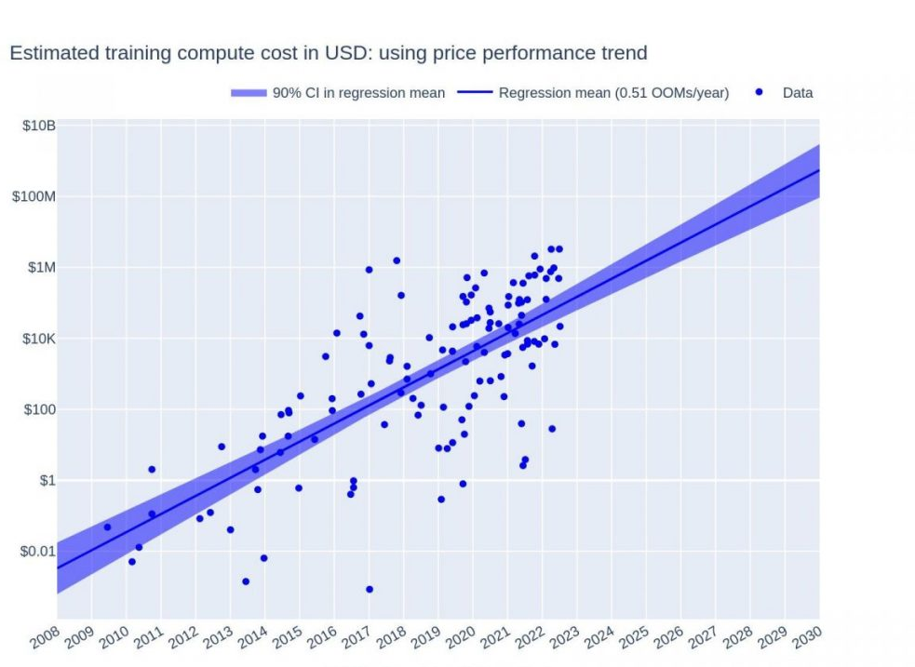
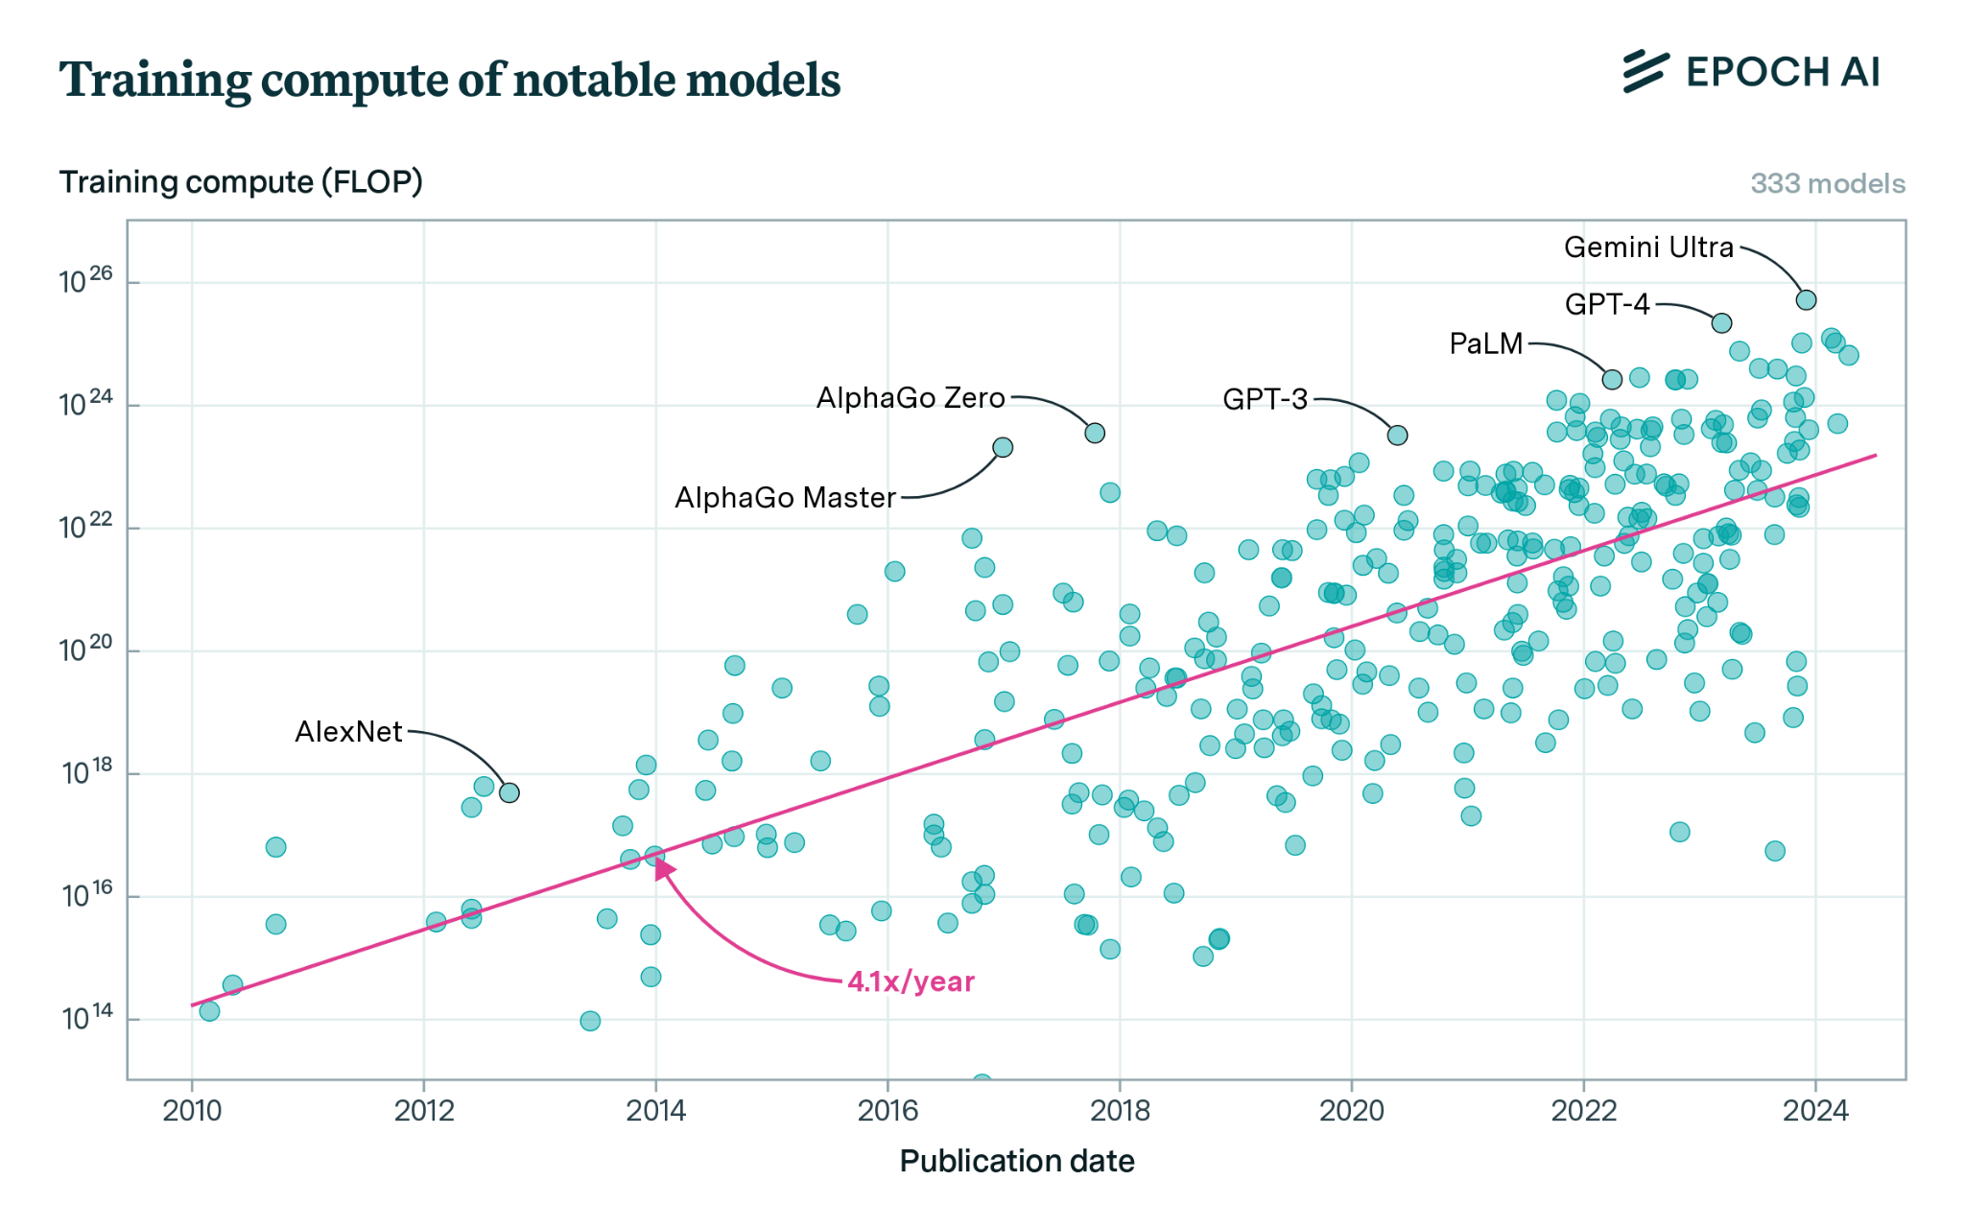
Deep Learning: Huge models, huge training cost
Training Compute
Training cost
Training compute (FLOP)
Training cost in USD
Publication date of ML system
10
Epoch AI 2023: Training Compute of Frontier AI Models Grows by 4-5x per Year
Yalalov 2023: AI Model Training Costs Are Expected to Rise from $100 Million to $500 Million by 2030
Notes:
the compute used to train recent models grew 4-5x yearly from 2010 to May 2024
AI Model Training Costs Are Expected to Rise from $100 Million to $500 Million by 2030

Slide 11
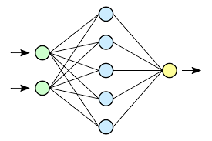
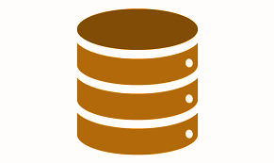
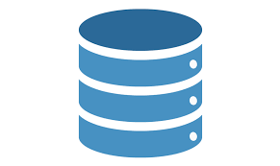
Save Costs with Pre-trained Models (PTMs)
PTM: A neural network that is already parameterized for an application
0.1
9.5
PTM =
. . .
Original application
(general dataset)
Example use: Transfer learning
PTM(s)
Predictions
New application
(specialized dataset)
General-purpose PTM
(feature extractor)
Custom model elements
(new head)
Notes:
PTNN: This parameterization – weights associated with the neural network – is also called a checkpoint, since it is taken during the training of the neural network model
They allow the user to focus on fine tuning which is arguably easier than training from scratch
PTNN's trained on large datasets are often good at generalizing to other domains, having access to these PTNN' is very convenient
An example use:
Transfer learning: The user starts with a pre-trained neural network for a GENERAL task, and specializes it to their specific task. The user can take the generic part of a network and add trainable layers specific to the new task. The PTNN is used as a backbone (baseline feature extractor). This approach supports innovation, since many different datasets and downstream model layers can be explored on top of the backbone.
============
PTNNs are also used for knowledge distillation. It essentially acts as a form of model compression, where the learned weights and biases of either the input layer, hidden layers, or the output layer is transferred to a smaller model. Unlike the previous two methods, the knowledge from the cumbersome model is now distilled and input into the smaller model. For smaller mobile applications and systems with limited computational capacity, knowledge distillation allows for a compressed model to learn from this larger network [1].
Finally, dataset labeling is a large benefit from pretrained neural networks. With the onset of these large models, accuracy and generalization become a large part of the equation. As such, specific PTNNs have the capability to help users with smaller models label datasets to a great degree of accuracy. Instead of having to go through thousands of images, it’s possible for input data to be quickly labeled and used for training.
[1] https://arxiv.org/pdf/2006.05525.pdf

Slide 12
Where are PTMs from…

Slide 13



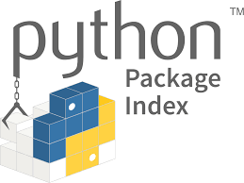






Software Packages Exchanging
Traditional
PTM
2016
2000
2004
2017
2017
2004
2010
2010
2018
2019

Slide 14
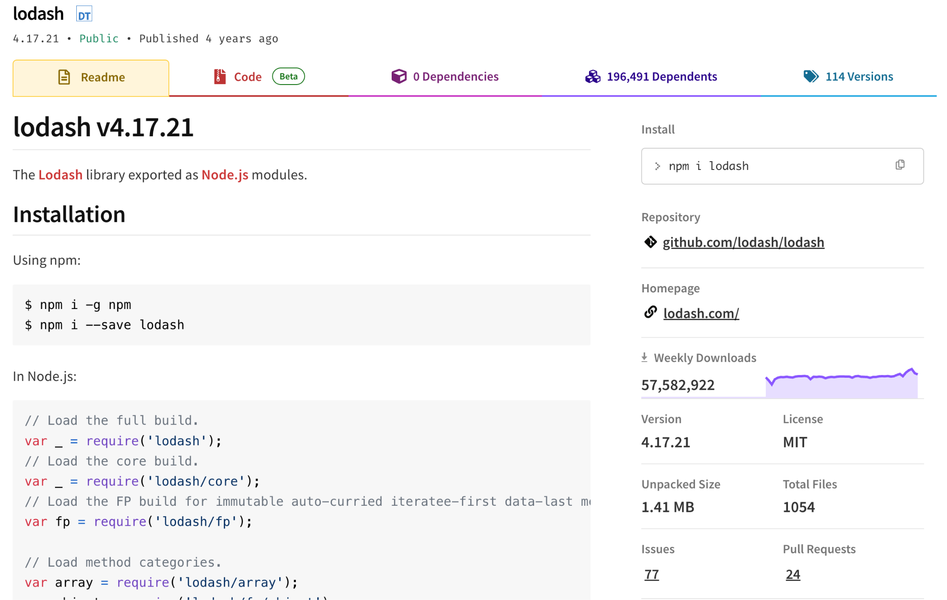
Traditional Software Packages

Slide 15
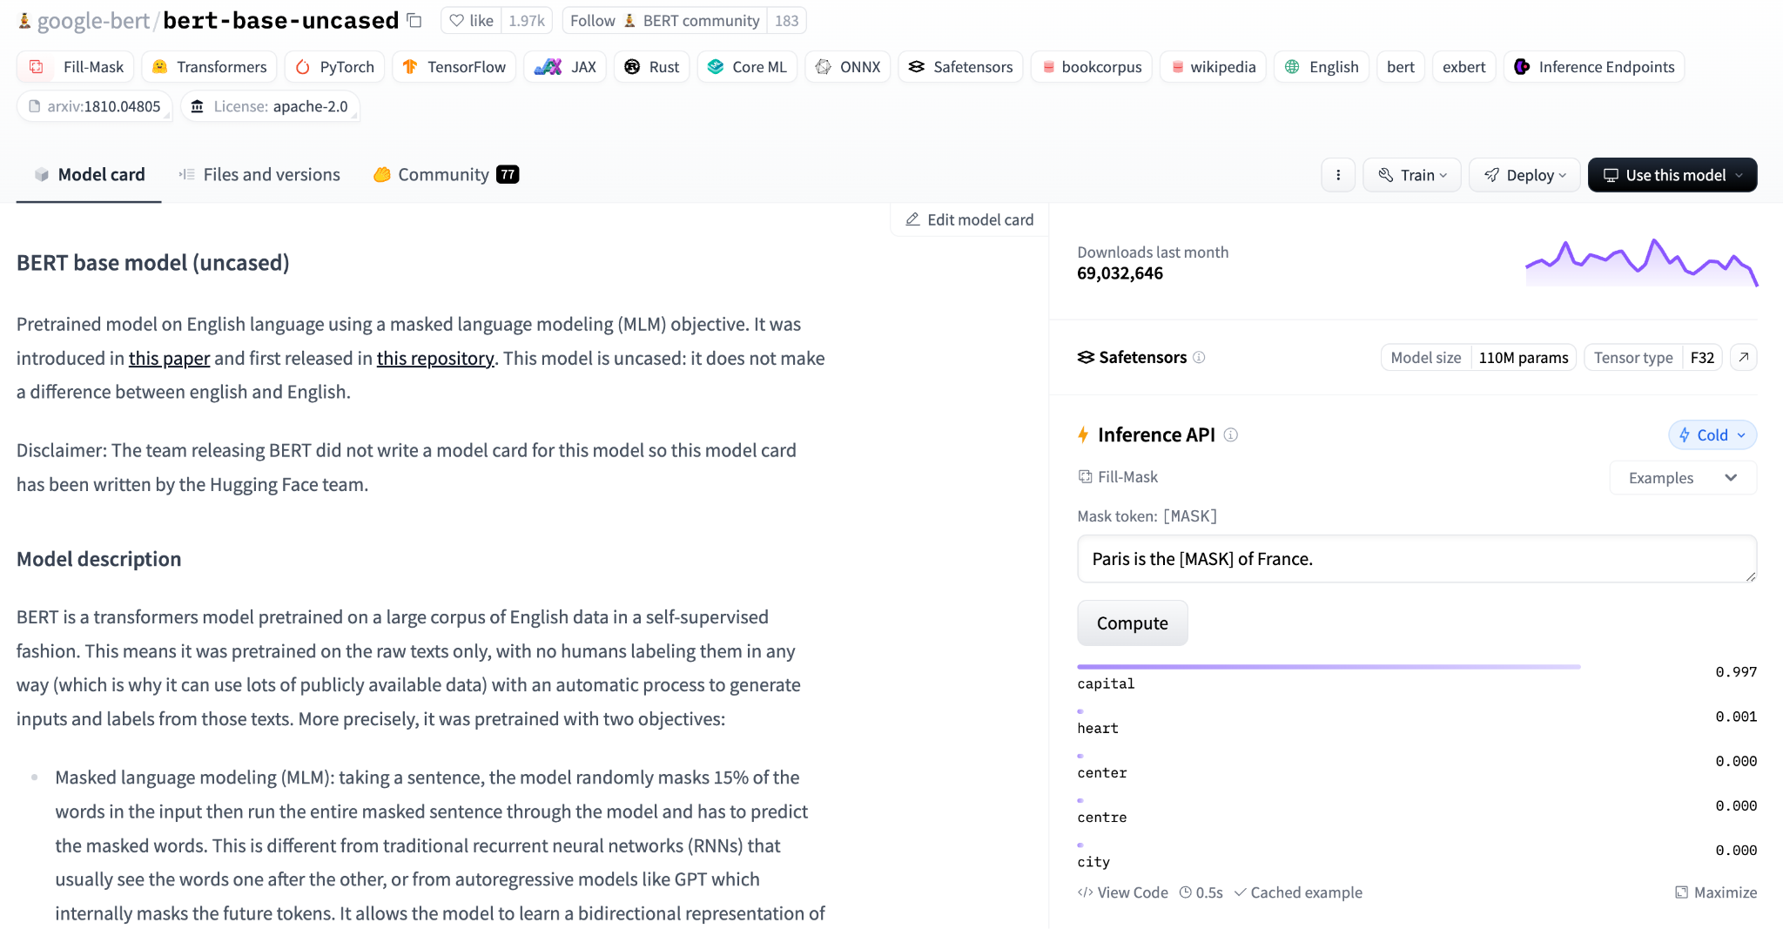
PTM Packages
Task
Libraries, Frameworks
Datasets
Architectures
Popularity
Demo
Documentation

Slide 16
Background
(Software) Engineering Reuse Process

Slide 17

Theoretical Engineering Reuse Process
What is prioritized?​
What is challenging?​
Integrate/Deploy
What is prioritized?​
Any risks?
Reengineer candidate(s)​
Evaluate candidates​
What is available?​
Identify candidates​
Specify requirement
[1] Sommerville, Ian. 2011: Software engineering. America: Pearson Education Inc.
[2] de Oliveira Barros, Márcio, Cláudia Maria Lima Werner, and Guilherme Horta Travassos. "Scenario Oriented Project Management Knowledge Reuse within a Risk Analysis Process." SEKE. 2001.
[3] Al-Badareen, Anas Bassam, et al. "An evaluation model for software reuse processes." Software Engineering and Computer Systems: Second International Conference, ICSECS 2011, Kuantan, Pahang, Malaysia, June 27-29, 2011, Proceedings, Part III 2. Springer Berlin Heidelberg, 2011.
[4] Ali, Nazakat, Horn Daneth, and Jang‐Eui Hong. "A hybrid DevOps process supporting software reuse: A pilot project." Journal of Software: Evolution and Process 32.7 (2020): e2248.
17

Slide 18
Background
Trust in (Software) Reuse

Slide 19
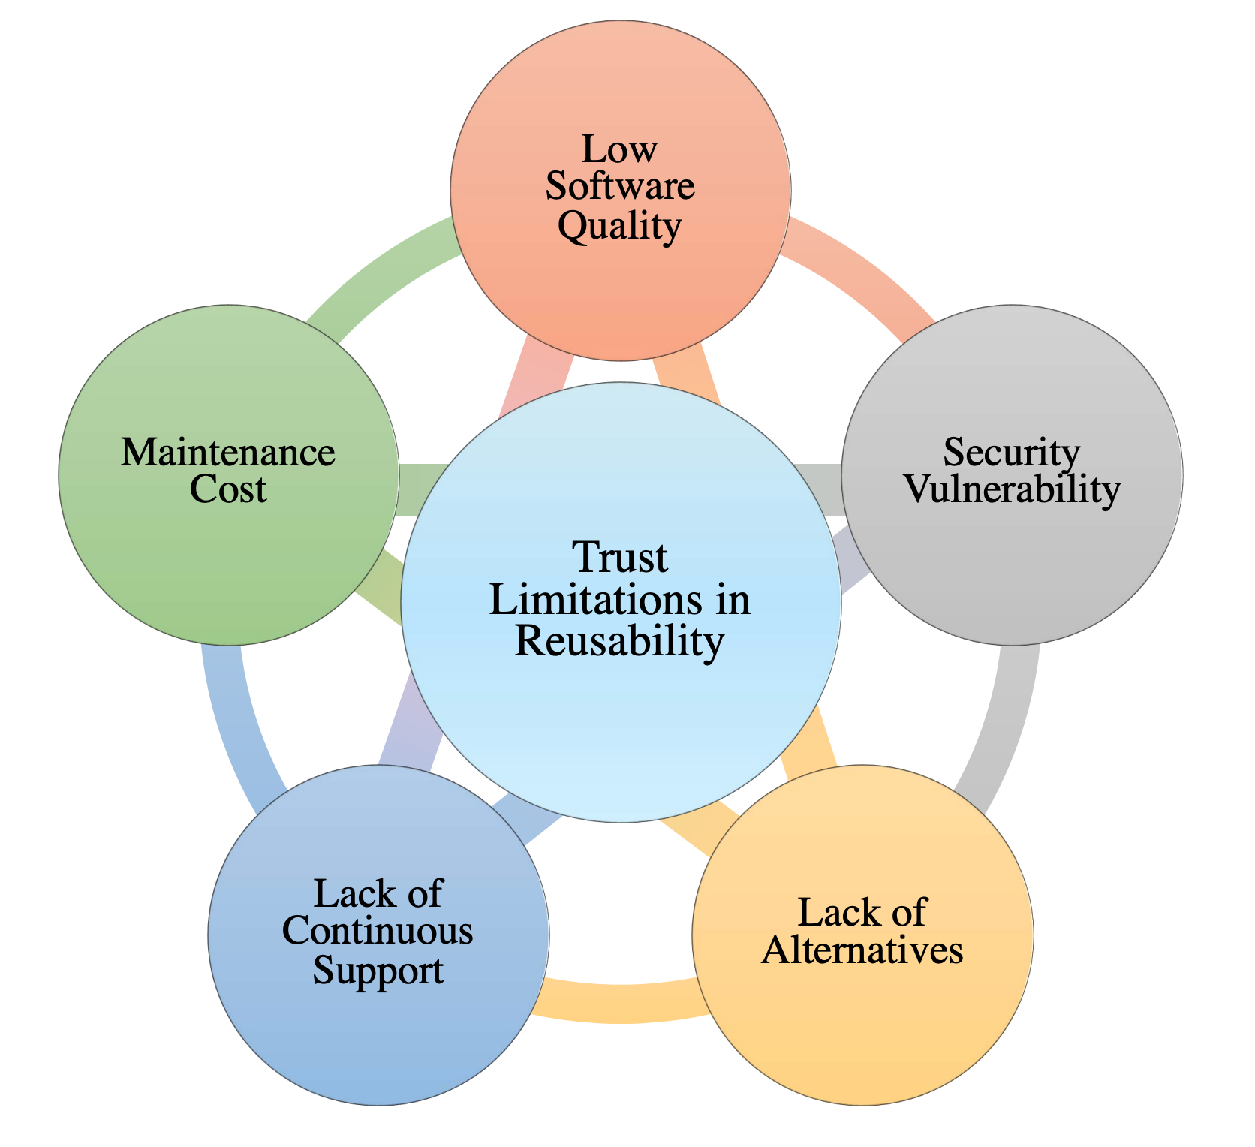

Trustworthiness in Software Reuse
How about trust in PTM reuse?
19
Ghofrani, etal. 2022: Trust challenges in reusing open source software: An interview-based initial study." Proceedings of the 26th ACM International Systems and Software Product Line Conference-Volume B.
Notes:
Low quality, malware, dependency risks, etc.

Slide 20
Putting together…
Reuse
Trad. Software
Background
Trust
PTMs

Slide 21
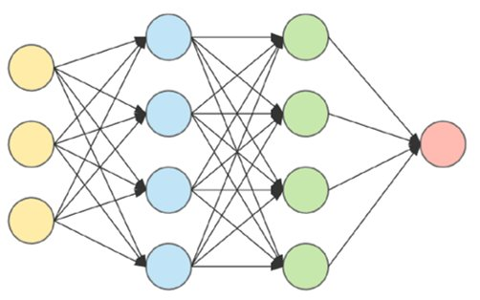




Trustworthy Reuse of PTMs
Reusability
What is prioritized?​
What is challenging?​
Integrate/Deploy
EMSE’24
What is prioritized?​
Any risks?
Reengineer candidate(s)​
Trust
Revised&Resubmitted at EMSE’25
Under Review at ICSE’26
Evaluate candidates​
What is available?​
MSR-Dataset’23,
MSR’24
Identify candidates​
PTM Supply Chain
ESEM’24, ICSE’23,
SCORED’22
Specify requirement
21

Slide 22
Part 1: Characterizing Trustworthiness of AI Model Reuse
22

Slide 23


What Do We Know So Far?
Reuse
Trad. Software
Background
Trust
PTMs
Reuse
Trust
Characterization

Slide 24
Topic 1
Challenges and Practices of Deep Learning Reengineering
[Presented in the Preliminary Exam]
[EMSE’24] Jiang, Banna, Vivek, Goel, Synovic, Klingensmith, Thiruvathukal, and Davis. Challenges and Practices of Deep Learning Model Reengineering: A Case Study on Computer Vision. Empirical Software Engineering (EMSE’24). 63 pages.
[arXiv’21] Banna, Chinnakotla, Yan, Vegesana, Vivek, Krishnappa, Jiang, Lu, Thiruvathukal, and Davis. An Experience Report on Machine Learning Reproducibility: Guidance for Practitioners and TensorFlow Model Garden Contributors. https://arxiv.org/abs/2107.00821. 2021.
[arXiv’24] Purohit, Jiang, Ravikiran, and Davis. A Partial Replication of MaskFormer in TensorFlow on TPUs for the TensorFlow Model Garden. https://arxiv.org/abs/2404.18801. 2024.

Slide 25
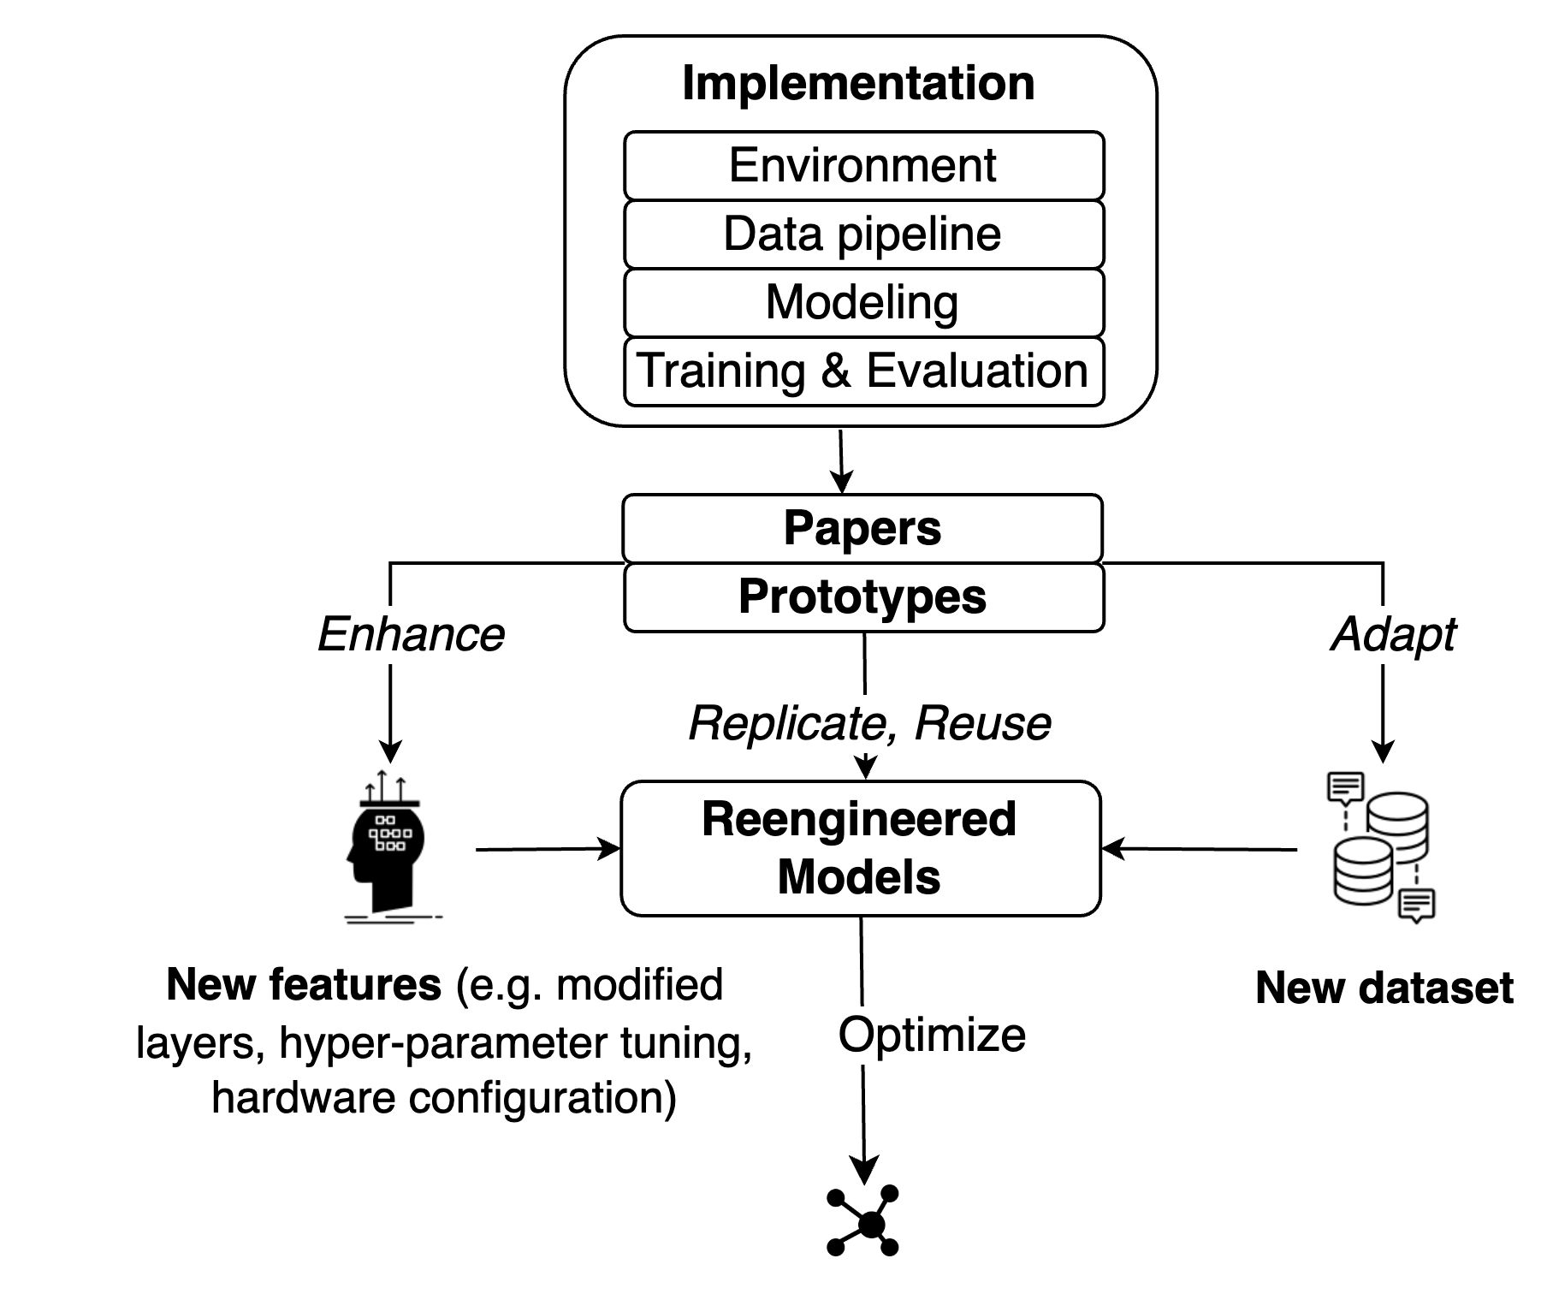
DL Model Engineering Life Cycle
Model engineering
(focus of prior work)
“Product” view
Model reengineering
(focus of our study)
“Process” view
“Beyond-the-product” interpretation of failures
→ better understanding how defects arise
25

Slide 26
Results – DL Reengineering Challenges
Model operationalization
“Understanding the previous work is often the most difficult part ...translating that information and transmitting that information in an efficient way can be very hard”
“The only way to validate that your model is correct is to...train it, but the pitfall is that many people only write the code for the model without any training code...That, in my opinion, is the biggest pitfall.”
Other challenges:
Performance Debugging, Portability of DL Operations*, and Customized Data Pipeline
We also asked about mitigations, one highlight was the difficulty in testing
26
[ISSTA’24] Jajal, Jiang, Tewari, Woo, Lu, Thiruvathukal, and Davis. Analysis of Failures and Risks in Deep Learning Model Converters: A Case Study in the ONNX Ecosystem. Proceedings of the 33rd ACM SIGSOFT International Symposium on Software Testing and Analysis (ISSTA’24). 13 pages.

Slide 27
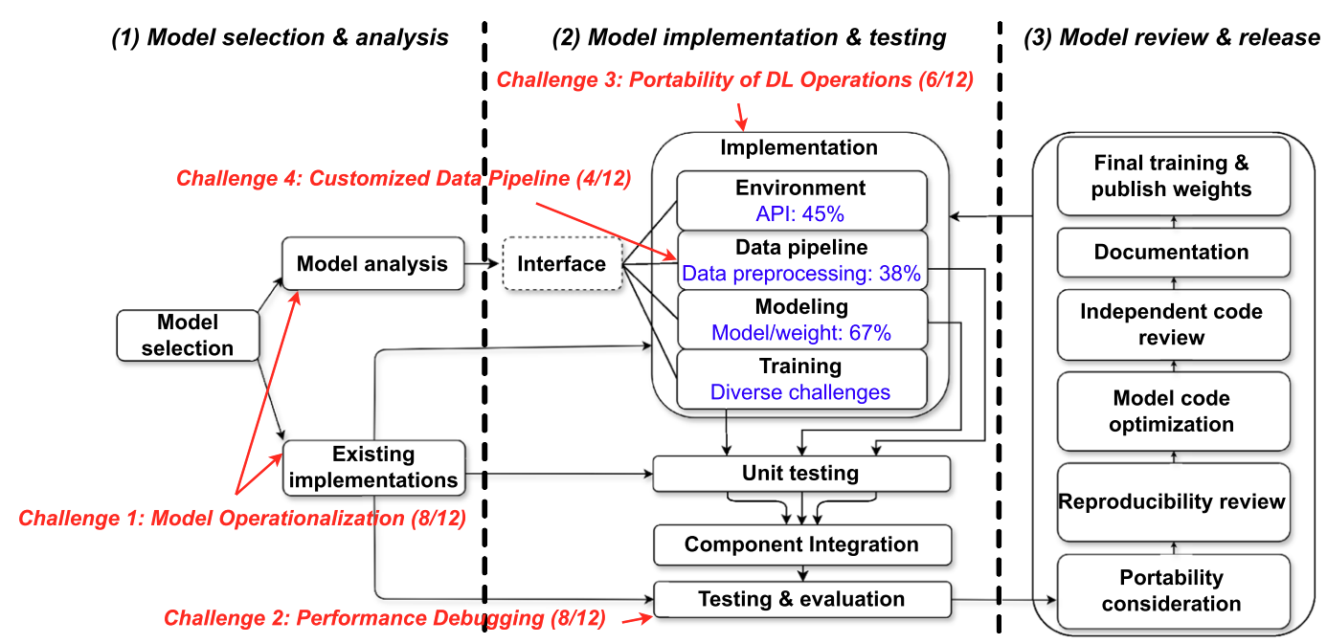
DL Reengineering Workflow
27

Slide 28
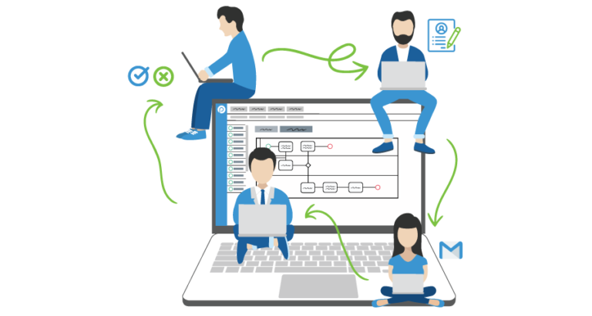

Takeaway Message
DL Reengineering is a challenging process…
Background
but could be more efficient with more work on standardization, validation, and automated tools!
Characterization
Reuse
Trust
28
Notes:
Standardized practices
Support for Reengineering Validation
Beyond manual reengineering
Further empirical work

Slide 29
Topic 2
Trustworthy Reuse of PTMs
[Presented in the Preliminary Exam]
[SCORED’22] Jiang, Synovic, Sethi, Indarapu, Hyatt, Schorlemmer, Thiruvathukal, Davis. An Empirical Study of Artifacts and Security Risks in the Pre-trained Model Supply Chain. Proceedings of the 1st ACM Workshop on Software Supply Chain Offensive Research and Ecosystem Defenses (SCORED) 2022.
[ICSE’23] Jiang, Synovic, Hyatt, Schorlemmer, Sethi, Lu, Thiruvathukal, Davis. An Empirical Study of Pre-Trained Model Reuse in the Hugging Face Deep Learning Model Registry. Proceedings of the 45th International Conference on Software Engineering (ICSE) 2023.
[JVA’23] Davis, Jajal, Jiang, Schorlemmer, N. Synovic, and G.K. Thiruvathukal. Reusing Deep Learning Models Challenges and Directions in Software Engineering. Proceedings of the IEEE John Vincent Atanasoff Symposium on Modern Computing (JVA) 2023.
[ESEM’24] Jones, Jiang, Synovic, Thiruvathukal, Davis. What do we know about Hugging Face? A systematic literature review and quantitative validation of qualitative claims. In Proceedings of the 18th ACM/IEEE International Symposium on Empirical Software Engineering and Measurement (ESEM) 2024.
Notes:
Consider the software engineer.
* What tasks do they perform?
- Lots of traditional activities such as computer programming, data management, data transmission, collaborative engineering, and deployment. More recently working with machine learning technologies such as neural networks.
What tools do they use to assist them in these tasks?
*Flip through some tool families
One aspect of software engineering research is to understand the ways that engineers use these tools, in order to
1.Identify problems with the tools
2.Identify ways we can improve these tools
3.Identify opportunities for new tools
When tools are used incorrectly, bad things happen.
The engineering process may be inefficient, or the quality of the engineering product may be affected.
TRANS
Today I’m going to talk about engineering practices and challenges for one of these domains: machine learning, and specifically, deep learning / neural networks.
=====
Editing:
-VSCode
-IntelliJ
-Eclipse
-Emacs
Interacting with data
-MySQL
-MongoDB (noSQL)
-GraphQL
Communication:
-JSON
-Protobuf
Working with other developers:
-Version control
-CI tools like Travis
Virtualization:
- Docker
- Kubernetes
Deployment, e.g. serverless frameworks like
- AWS lambda
- Google cloud functions
-Apache OpenWhisk
-
Neural networks:
- Development frameworks like PyTorch and TensorFlow; model hubs such as HuggingFace; exchange formats such as ONNX

Slide 30
Lack of Knowledge
How is this similar to / different from regular software packages?
Little literature about DL software packages (PTMs)
Reuse and trust are unexamined in DL model registries

Slide 31
Why PTM Reuse is hard?
Missing attributes:
•“Missing details of models”
•“Performances of the published models are unclear”
•“Different authors process data differently, so it cannot be easily compared”
Discrepancies:
•“Some of the models are over-promising”
•“Model names are not named correctly and sometimes the provided scripts are broken”
Security and Privacy Risks:
•“The model deployment and data transmission are not in their control”
•“It is hard to know what exactly generated the model because most training logs are missing”
•“If the model is trained with malicious intents. It could have a lot of consequences in the real world”
10/12, 83%
Transparency (Trust)
Comparability (Reuse)
9/12, 75%
Discrepancy (Trust + reuse)
Lack of maintenance (Reuse)
3/12, 25%
Privacy (Trust)
Security (Trust)
Notes:
TODO: Connect this to open/active/solved problems in DL. E.g “No scanner” is an open problem in DL.

Slide 32
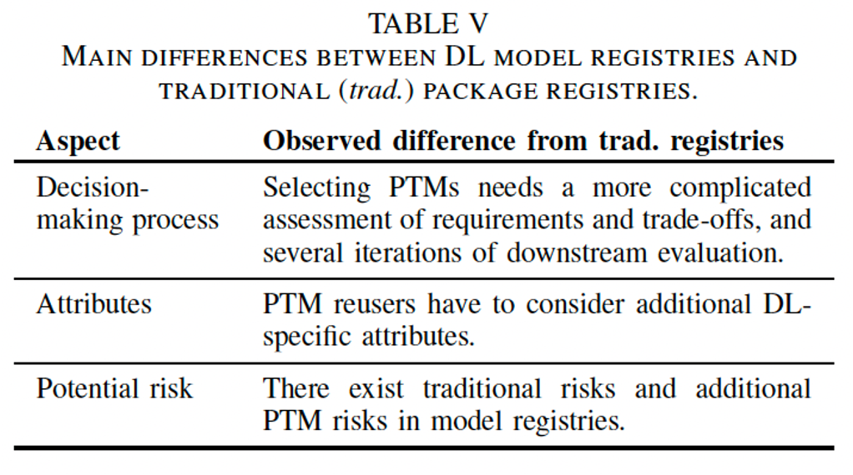
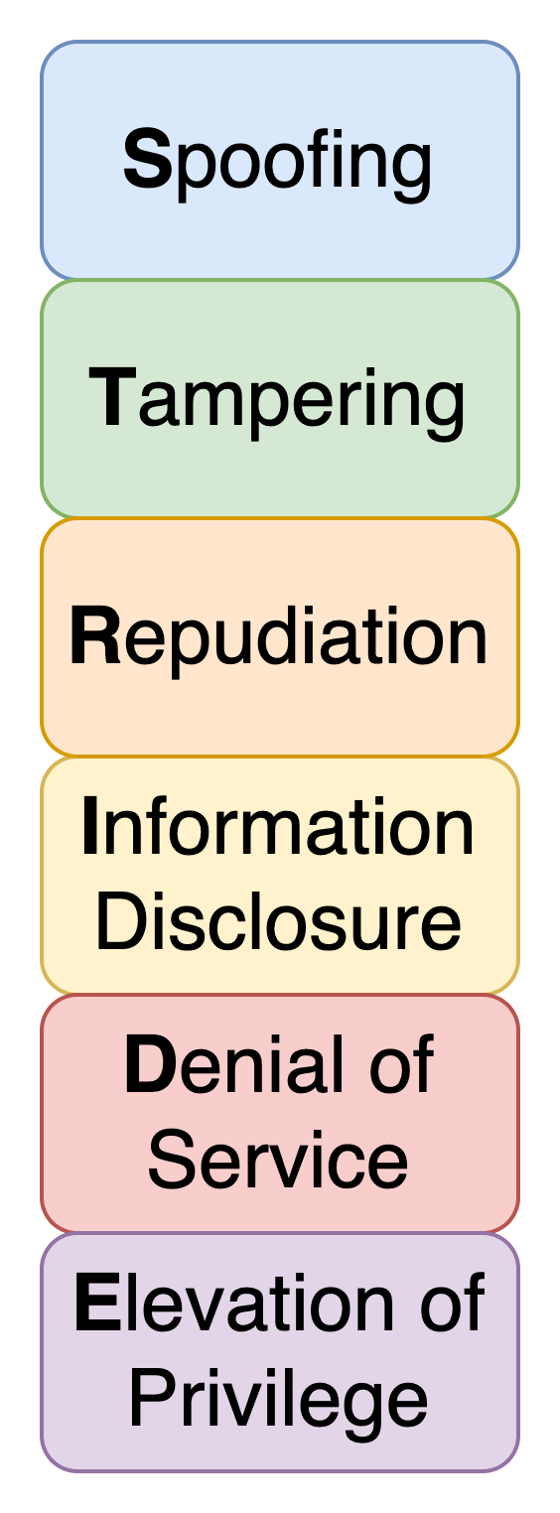
PTM Package vs. Traditional Package
STRIDE Analysis
Notes:
We substantiate our findings with a risk mitigation measurement in the HF ecosystem using STRIDE methodology for threat modeling and risks assessment
STRIDE analysis focuses on trust assumptions related to data, making it suitable for PTMs.
**STRIDE: Spoofing involves impersonating a user or system, Tampering involves unauthorized modification of data, Repudiation refers to denying involvement in an action, Information disclosure is the exposure of sensitive information, Denial of service disrupts normal operations, and Elevation of privilege allows unauthorized access to restricted resources.
Spoofing: Involves illegally accessing and then using another user's authentication information, such as username and password
Tampering: Involves the malicious modification of data.
Repudiation: Associated with users who deny performing an action without other parties having any way to prove otherwise
Information Disclosure: Involves the exposure of information to individuals who are not supposed to have access to it
Denial of Service: Denial of service (DoS) attacks deny service to valid users
Elevation of Privilege: An unprivileged user gains privileged access and thereby has sufficient access to compromise or destroy the entire system.

Slide 33

Takeaway Message
PTM reuse is an emerging (emerged?) form of software reuse, with novel characteristics
Aspects of PTM reuse are different from traditional software packages…
We have only scratched the surface of PTM reuse
Background
Characterization
Reuse
Trust
Notes:
Of course there's more work to do and I'll talk more about that at the end, but these studies have shed the first light on PTM reuse

Slide 34
Topic 3
Datasets of PTMs in Open-Source Software
[Presented in the Preliminary Exam]
[MSR’24] Jiang, Yasmin, Jones, Synovic, Kuo, Bielanski, Yuan, Thiruvathukal, and Davis. PeaTMOSS: Mining Pre-Trained Models in Open-Source Software. Proceedings of the 21th Annual Conference on Mining Software Repositories (MSR’24). 13 pages.
[MSR-Dataset’23] Jiang, Synovic, Jajal, Schorlemmer, Tewari, Pareek, Thiruvathukal, and Davis. PTMTorrent: A Dataset for Mining Open-source Pre-trained Model Packages. Proceedings of the 20th Annual Conference on Mining Software Repositories — Data and Tool Showcase Track (MSR-Dataset’23). 5 pages.
Notes:
Consider the software engineer.
* What tasks do they perform?
- Lots of traditional activities such as computer programming, data management, data transmission, collaborative engineering, and deployment. More recently working with machine learning technologies such as neural networks.
What tools do they use to assist them in these tasks?
*Flip through some tool families
One aspect of software engineering research is to understand the ways that engineers use these tools, in order to
1.Identify problems with the tools
2.Identify ways we can improve these tools
3.Identify opportunities for new tools
When tools are used incorrectly, bad things happen.
The engineering process may be inefficient, or the quality of the engineering product may be affected.
TRANS
Today I’m going to talk about engineering practices and challenges for one of these domains: machine learning, and specifically, deep learning / neural networks.
=====
Editing:
-VSCode
-IntelliJ
-Eclipse
-Emacs
Interacting with data
-MySQL
-MongoDB (noSQL)
-GraphQL
Communication:
-JSON
-Protobuf
Working with other developers:
-Version control
-CI tools like Travis
Virtualization:
- Docker
- Kubernetes
Deployment, e.g. serverless frameworks like
- AWS lambda
- Google cloud functions
-Apache OpenWhisk
-
Neural networks:
- Development frameworks like PyTorch and TensorFlow; model hubs such as HuggingFace; exchange formats such as ONNX

Slide 35
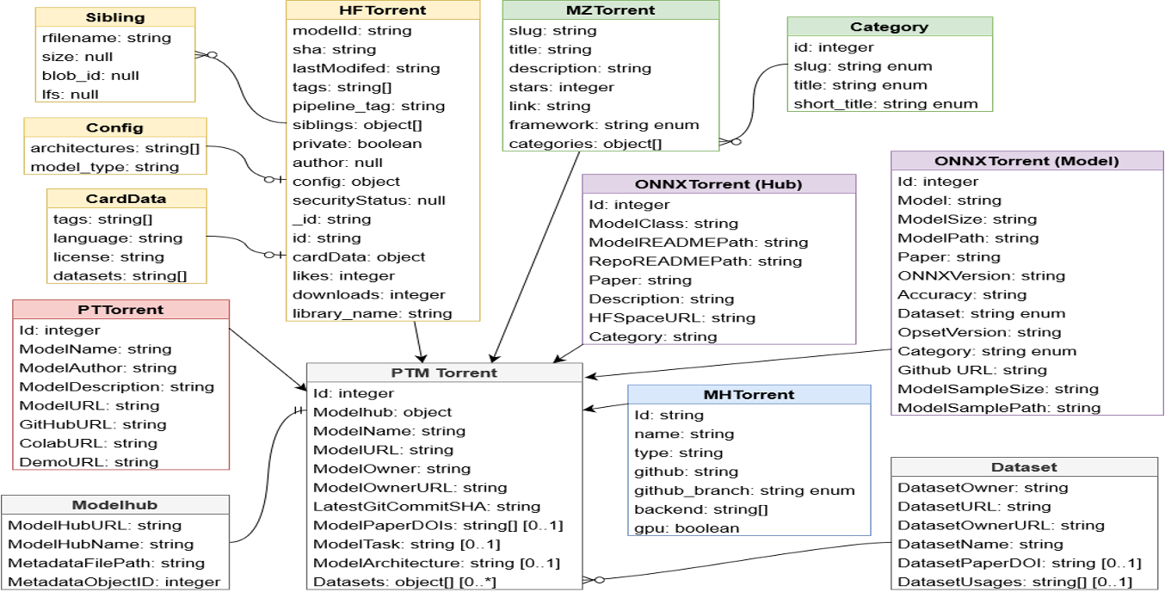
Dataset 1: PTMTorrent - Data Schema
[MSR’23-Dataset]

Slide 36
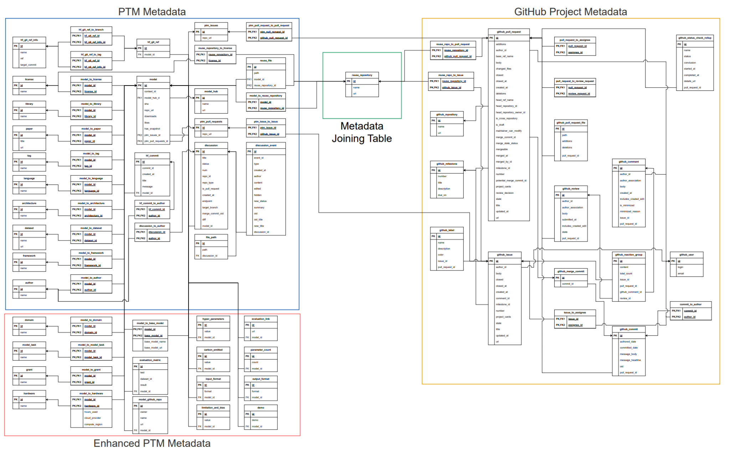
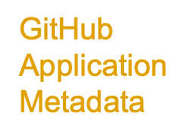
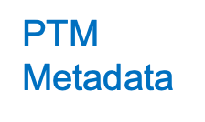



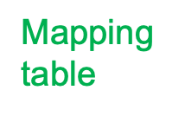
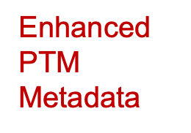

Dataset 2: PeaTMOSS - Data Schema
[MSR’24]
Notes:
Here is the overview of our database schema.
PTM Metadata, Mapping table connecting the upstream PTM package to downstream GitHub Applications, GitHub Application metadata, Enhanced PTM metadata.
I understand that this is hard to read… Let me give you more details.

Slide 37
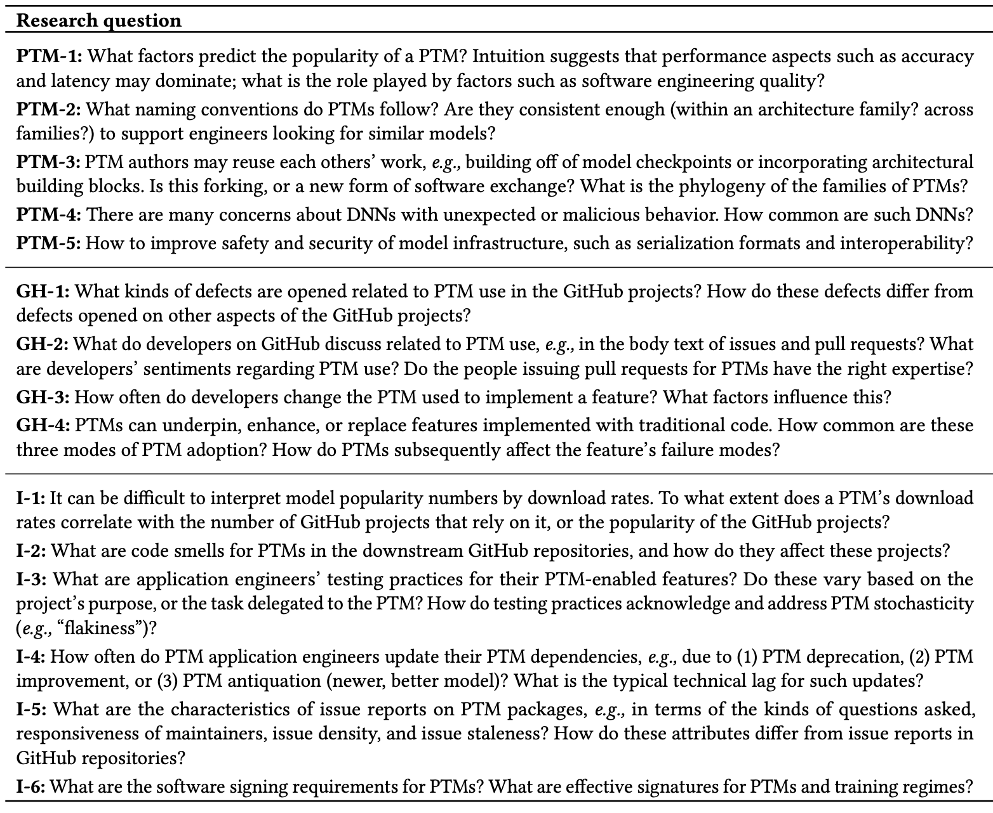

Takeaway Message
PTM reuse is still under discovered…
There are many directions to be work on!
PTM
GitHub
Proposed 15 future directions
Integration

Slide 38
Part 2: Improving Trustworthy Reuse in AI Model Supply Chain
38

Slide 39
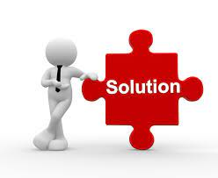
What Do We Know So Far?
Reuse
Trad. Software
Trust
Background
PTMs
Characterization
Reuse
Trust
Enhancement

Slide 40
Topic 4
Enhancing PTM Naming Practices and Consistency
[Proposed in the Preliminary Exam]
[Revised&Resubmitted to EMSE’25] Jiang, Kim, Cheung, Kim, Thiruvathukal, and Davis. “I see models being a whole other thing”: An Empirical Study of Pre-Trained Model Naming Conventions and A Tool for Enhancing Naming Consistency. (Revised&Resubmitted to EMSE’25). 67 pages.
Notes:
Consider the software engineer.
* What tasks do they perform?
- Lots of traditional activities such as computer programming, data management, data transmission, collaborative engineering, and deployment. More recently working with machine learning technologies such as neural networks.
What tools do they use to assist them in these tasks?
*Flip through some tool families
One aspect of software engineering research is to understand the ways that engineers use these tools, in order to
1.Identify problems with the tools
2.Identify ways we can improve these tools
3.Identify opportunities for new tools
When tools are used incorrectly, bad things happen.
The engineering process may be inefficient, or the quality of the engineering product may be affected.
TRANS
Today I’m going to talk about engineering practices and challenges for one of these domains: machine learning, and specifically, deep learning / neural networks.
=====
Editing:
-VSCode
-IntelliJ
-Eclipse
-Emacs
Interacting with data
-MySQL
-MongoDB (noSQL)
-GraphQL
Communication:
-JSON
-Protobuf
Working with other developers:
-Version control
-CI tools like Travis
Virtualization:
- Docker
- Kubernetes
Deployment, e.g. serverless frameworks like
- AWS lambda
- Google cloud functions
-Apache OpenWhisk
-
Neural networks:
- Development frameworks like PyTorch and TensorFlow; model hubs such as HuggingFace; exchange formats such as ONNX

Slide 41
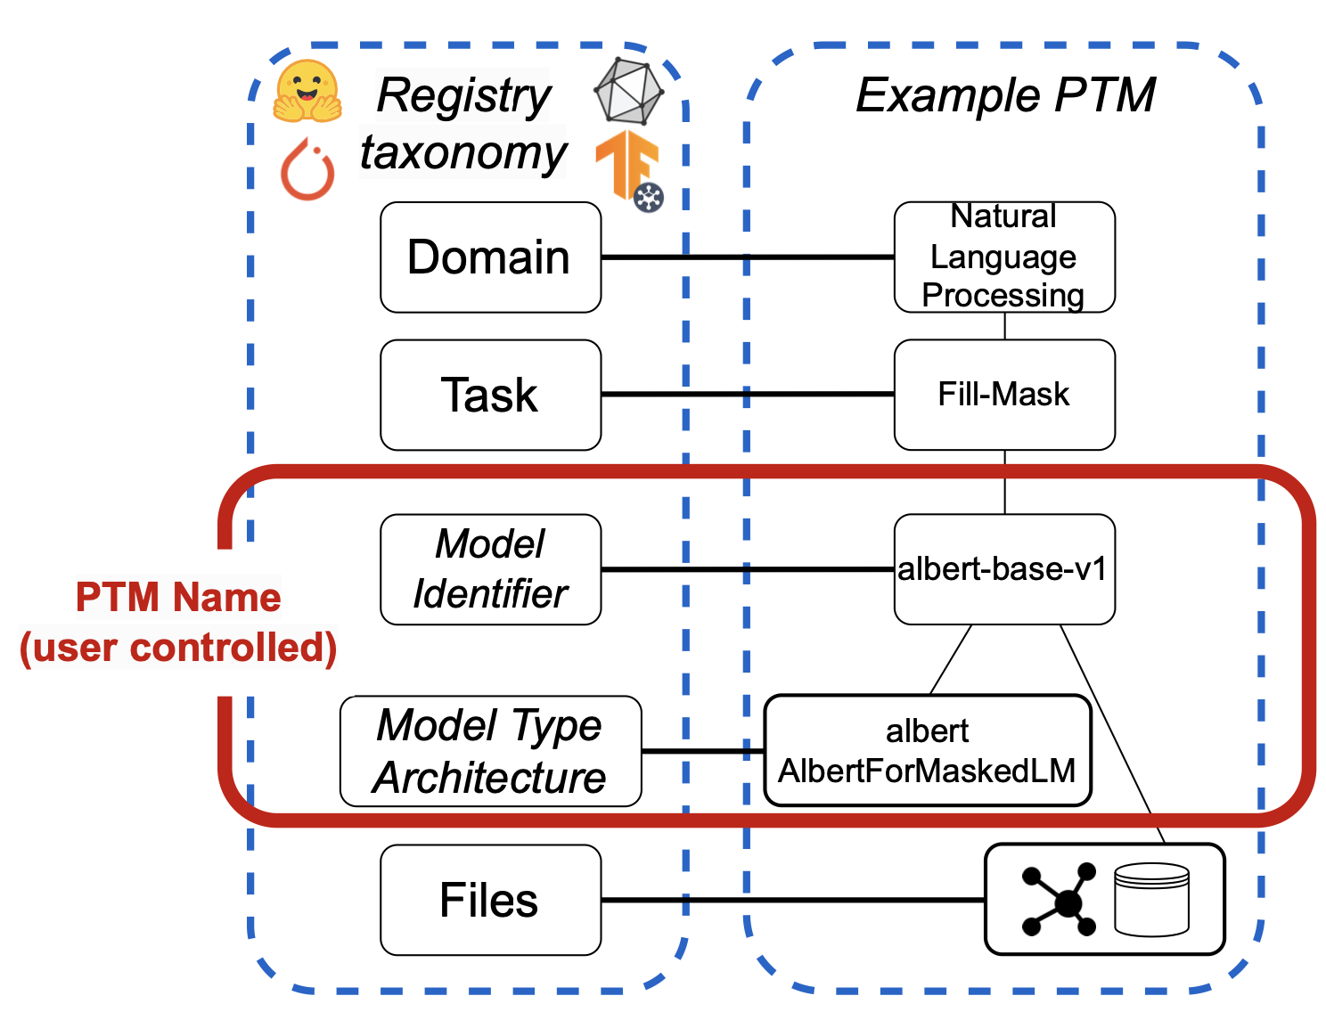
Hierarchy of PTM Naming Taxonomy

Slide 42

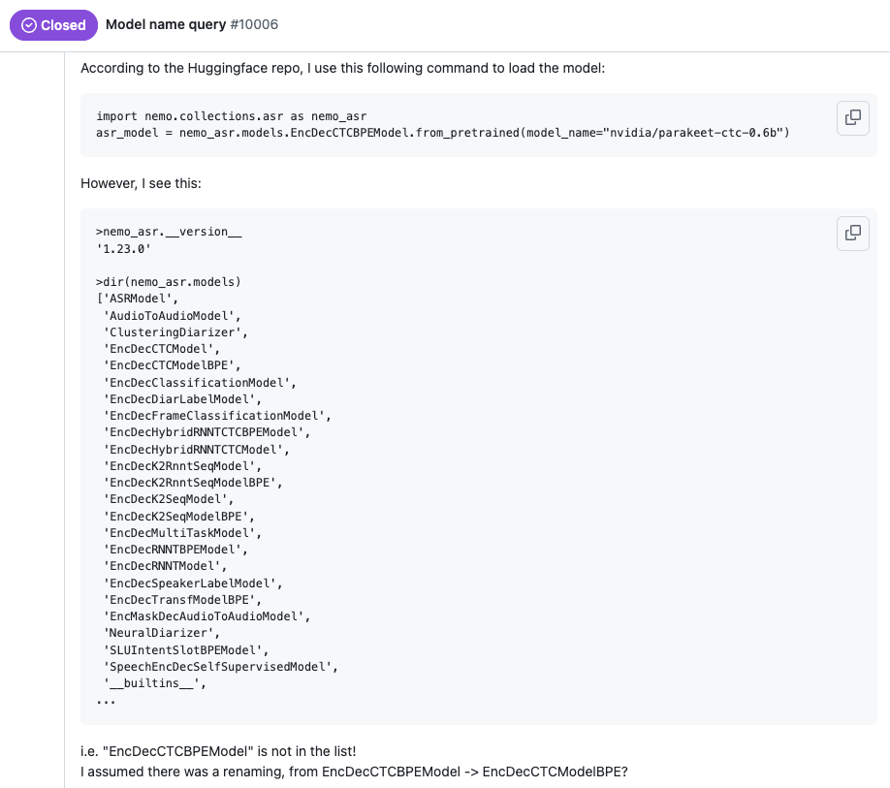
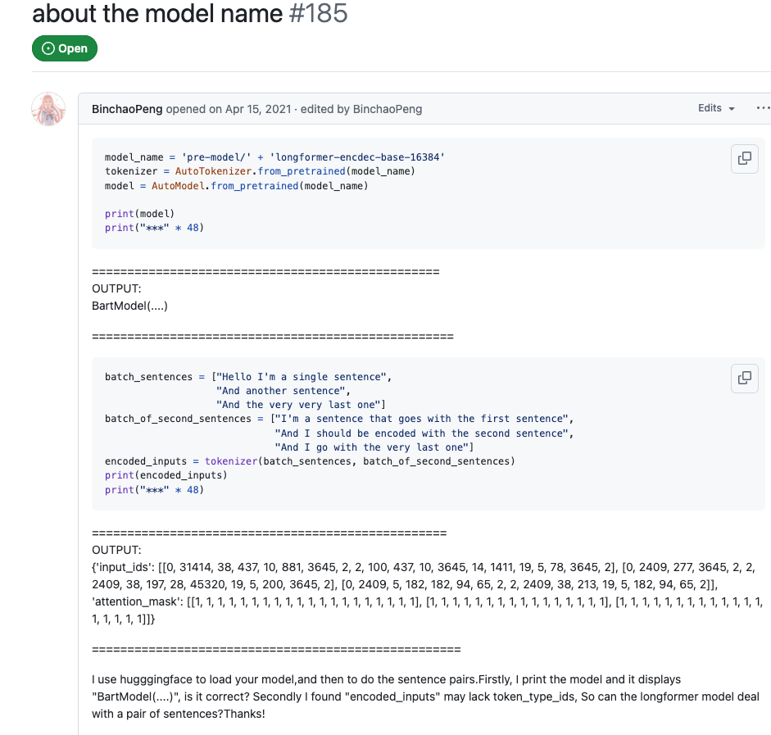
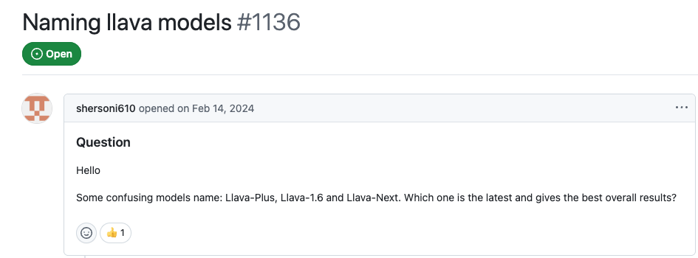
Inconsistent Naming Hinders Model Reuse
Notes:
- NVIDIA engineers made a typo in the model card of their speech recognition
model Parakeet (with 15K monthly downloads). The model_config incorrectly
specified EncDecCTCModel instead of EncDecRNNTModel. This inconsistent ar-
chitecture metadata caused users significant debugging effort and confusion
when attempting to load the model properly (NVIDIA 2024).
- Similarly, Longformer initially listed BartModel as its base architecture, which
confused users who expected to load it using LongformerModel. The issue was
later resolved when Hugging Face updated the configuration to correctly ref-
erence the LongformerModel class (Peng 2021).
– The LLaVA model also suffers from naming inconsistencies. For instance, users
have expressed confusion over similarly named models such as LLaVA-Plus,
LLaVA-1.6, and LLaVA-Next, with no clear guidance on which is the latest or
performs best overall (shersoni610 and Li 2024).chitecture, which
confused users who expected to load it using LongformerModel. The issue was
later resolved when Hugging Face updated the configuration to correctly ref-
erence the LongformerModel class (Peng 2021).

Slide 43
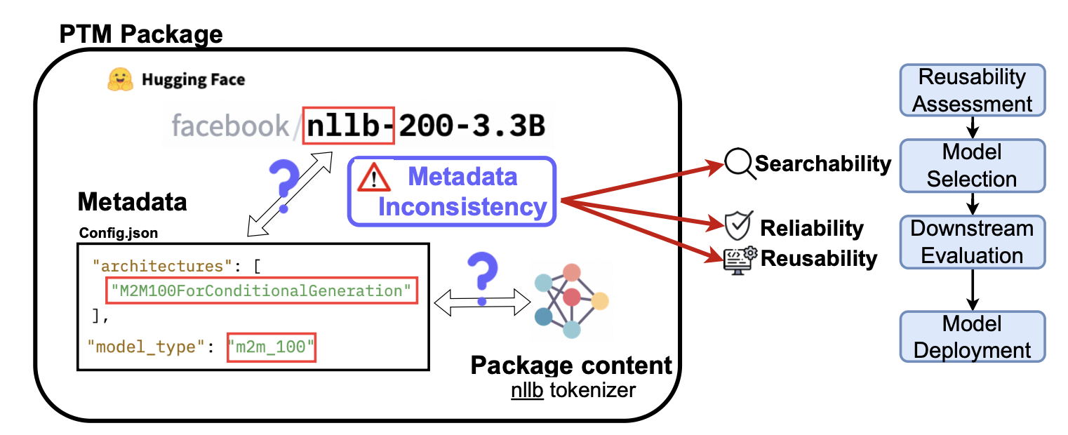
Importance of Accurate PTM Naming

Slide 44
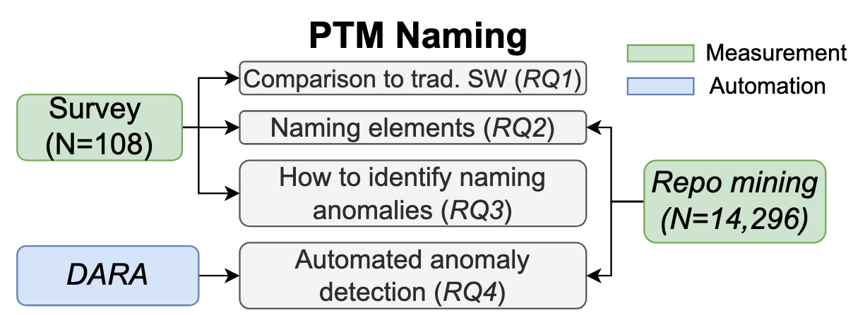
Overview of RQs and Methodologies
Notes:
This figure illustrates how PTM is involved in the research-to-practice pipeline in the Hugging Face PTM ecosystem [15]. Hugging Face is an open-gated model registry which means anyone can contribute models and package names to it [32]. This is in contrast to gated and commercial model hubs, where PTM packages are reviewed by registry staff or can only be submitted by authorized users such as employees. We highlight three kinds of users in the RTP pipeline in PTM ecosystem: researcher, reengineer, and adopter. These users are key components of the PTM supply chain [32]. The researchers are not only the new model contributors, but also the “name producer”. To support rapid model development and training, engineers (annotated as “reengineer” in Figure 1) can adapt existing deep learning models on downstream tasks or datasets through different reengineering approaches, including transfer learning, fine-tuning, and knowledge distillation [15, 24, 29].

Slide 45
Methodology - Survey
Demographics
Comparison to Traditional software
How is PTM naming similar/different from naming traditional packages?
Naming practices
Which naming convention do you prefer?
What naming elements are important?
What kind of modifications might necessitate a new model type/architecture?
Naming challenges
Do the PTMs accurately describe their behavior/content?
Do you think you would notice if a PTM had an incorrect name?
What process do you follow to find discrepancies?

Slide 46
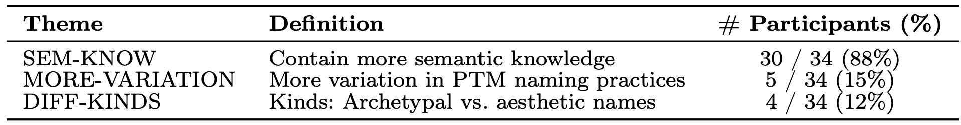
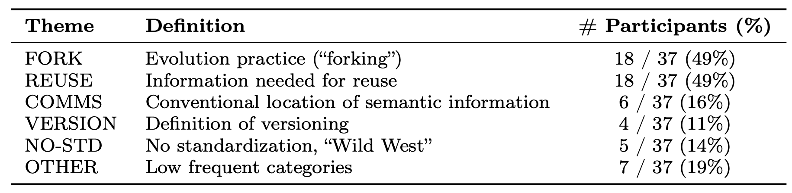
RQ1: PTM package vs. Traditional software packages
How PTM names differ?
Why PTM names differ?
Notes:
How: The primary difference
was in the greater amount of semantic knowledge in PTM names, as depicted
in Table 2. A representative answer was “Pre-trained model names often include
more specific information about the model’s architecture, training data, and per-
formance. This...detail is not typically included in traditional...package names.”
Other distinctions were that subjects observed greater variation in PTM name
Why:The two main explanations were
about evolution practices and reuse practices. One subject described the influence
of evolutionary practices on names as follows: “[Traditional] packages are not usu-
ally as directly built on previous ones, with small extensions added like for PTM.
Finetuning models generally means that the outputs are similar to the base, unlike
with traditional packages.” With respect to the information needed for reuse, a rep-
resentative quote was: “Traditional software packages are supposed to contain an
entire library...[with] various functions...and configuration...PTMs are generally
trained for a single objective...Therefore, [PTM] naming is critical for readability
and avoiding mistakes.”

Slide 47
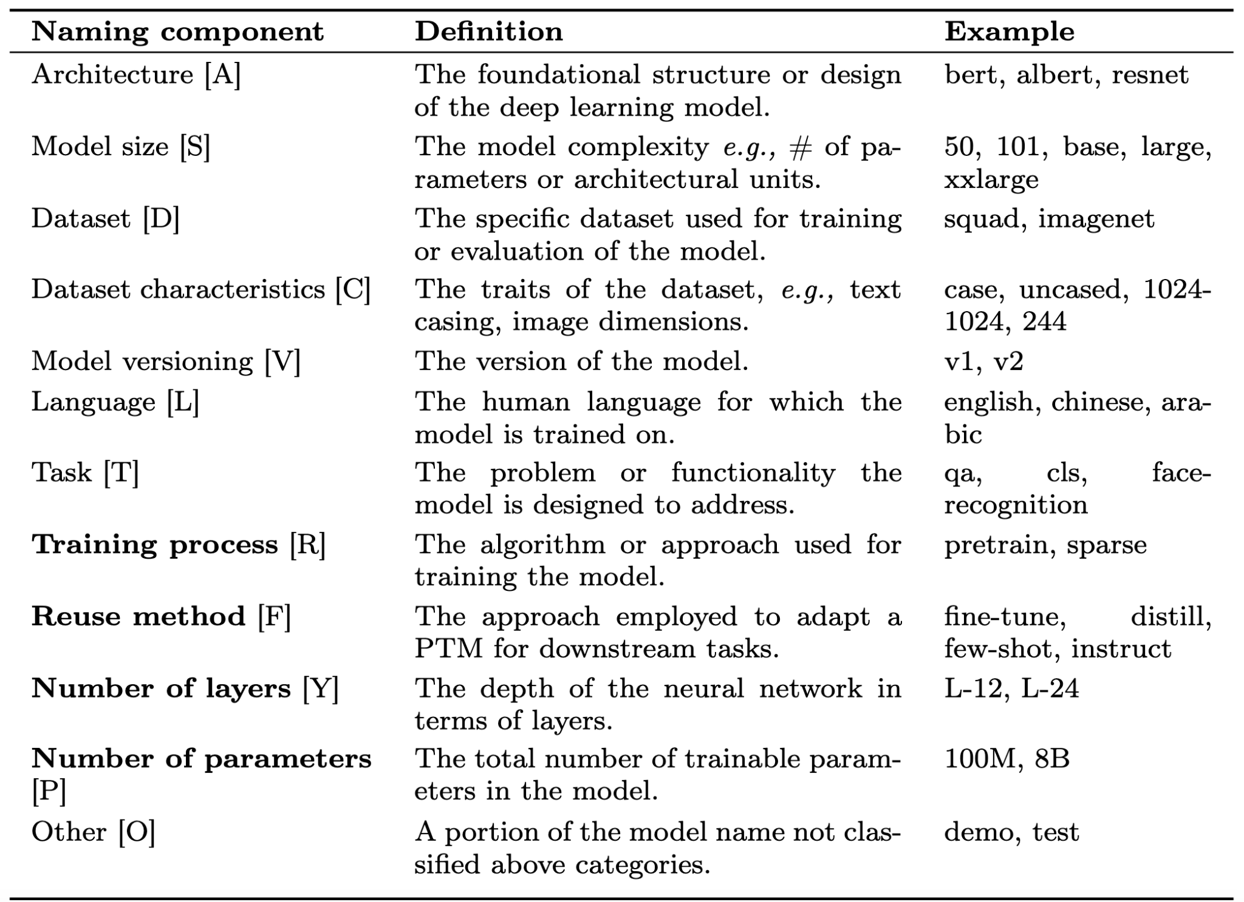
Methodology - Naming Elements

Slide 48
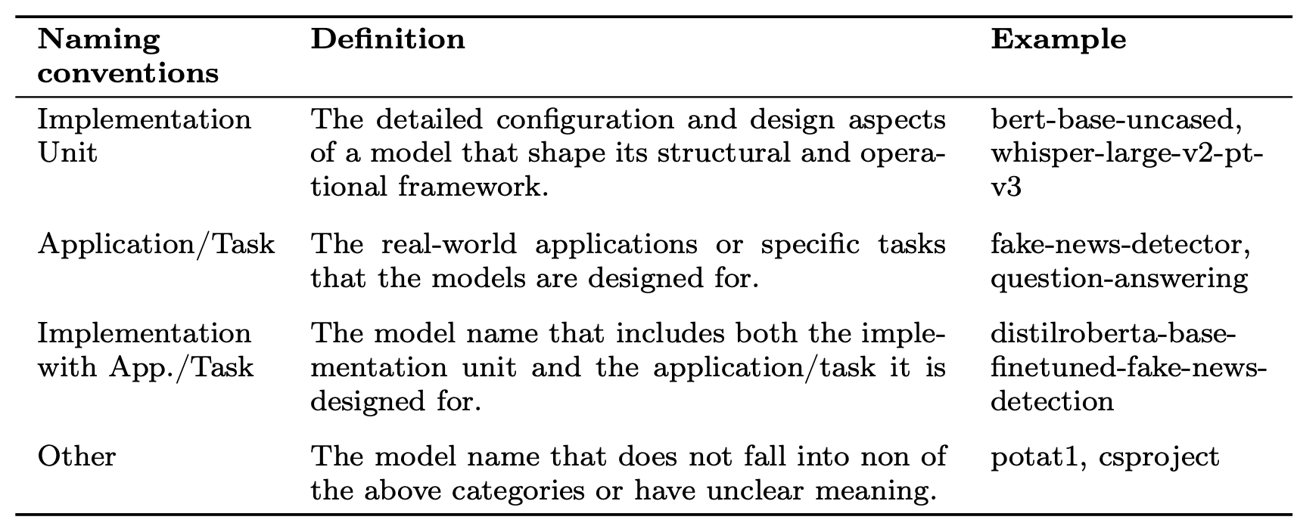
Methodology - Naming Conventions

Slide 49
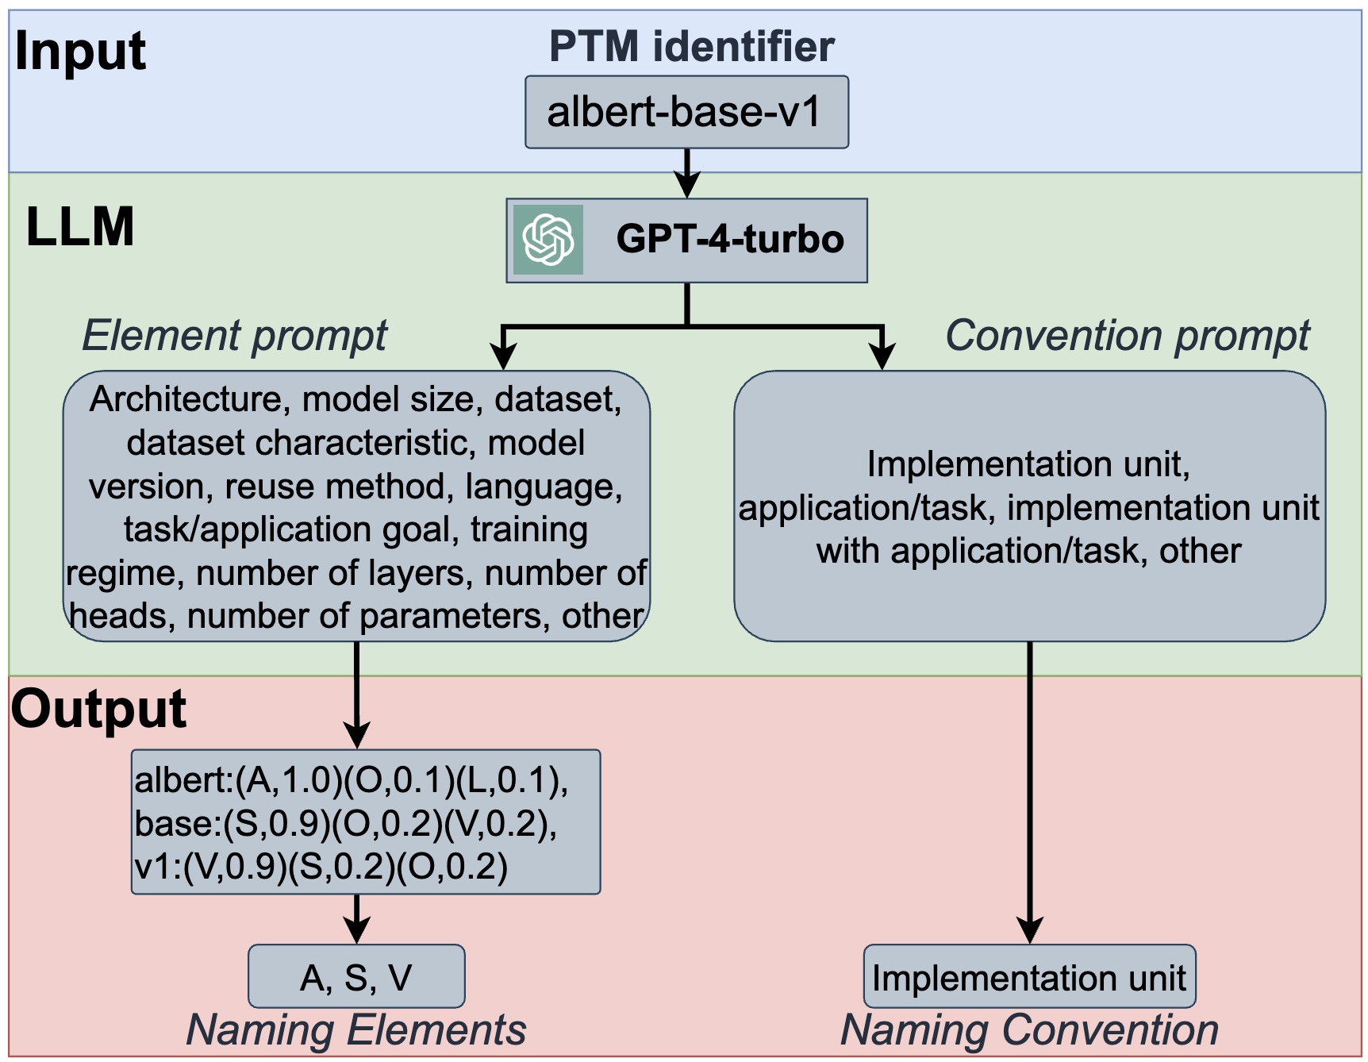
Methodology - Mining of PTM Names

Slide 50
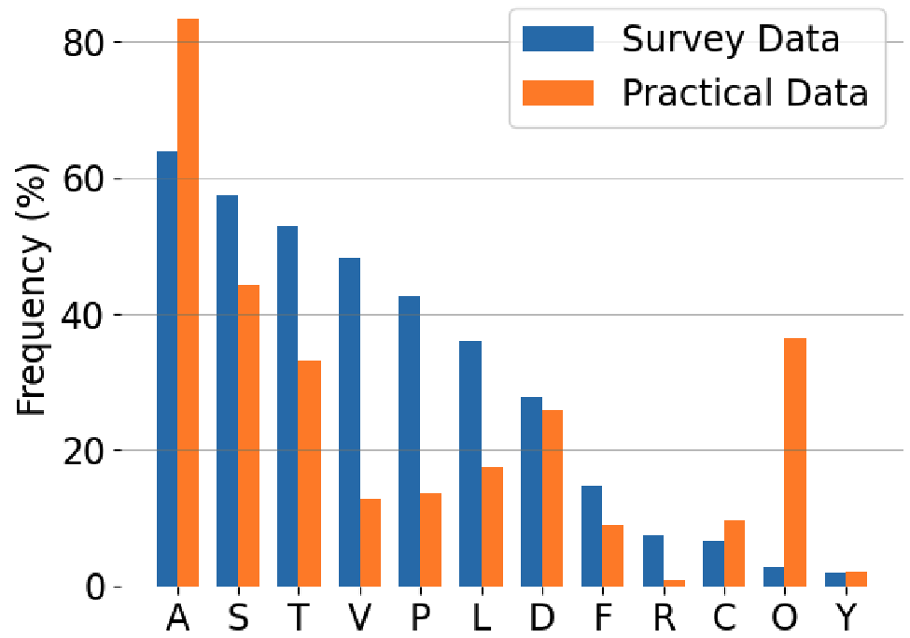
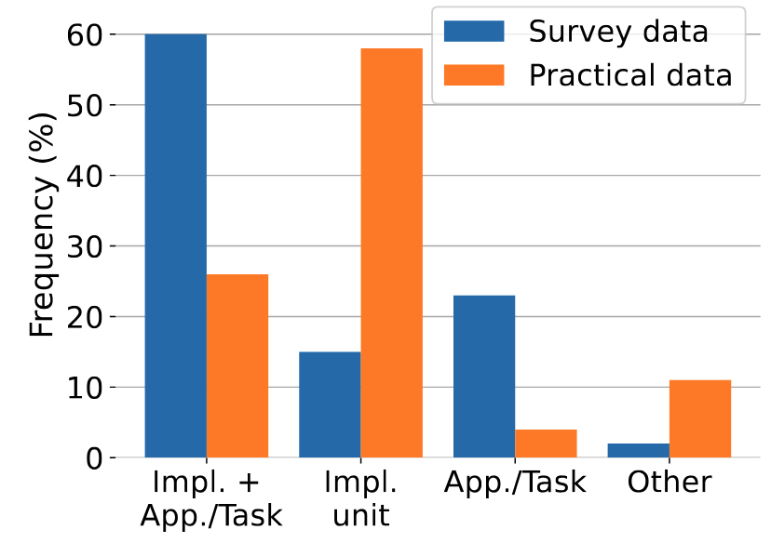
Results - PTM Name Analysis
RQ2: Survey vs. Practice
Naming elements:
Naming conventions:

Slide 51
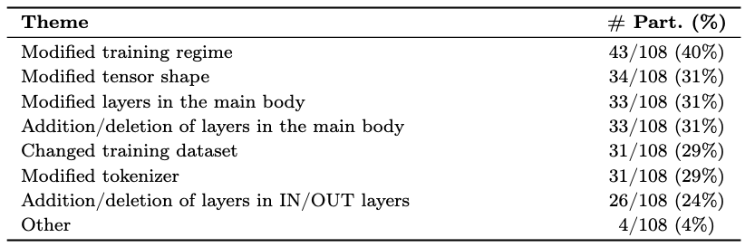
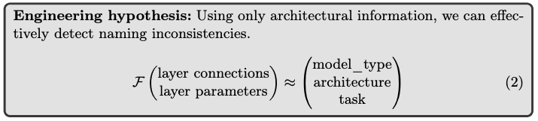
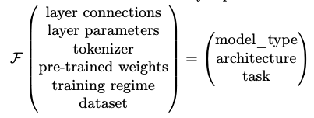
What kind of modifications might necessitate a new model type/architecture?
Can we automatically verify the correctness?

Slide 52
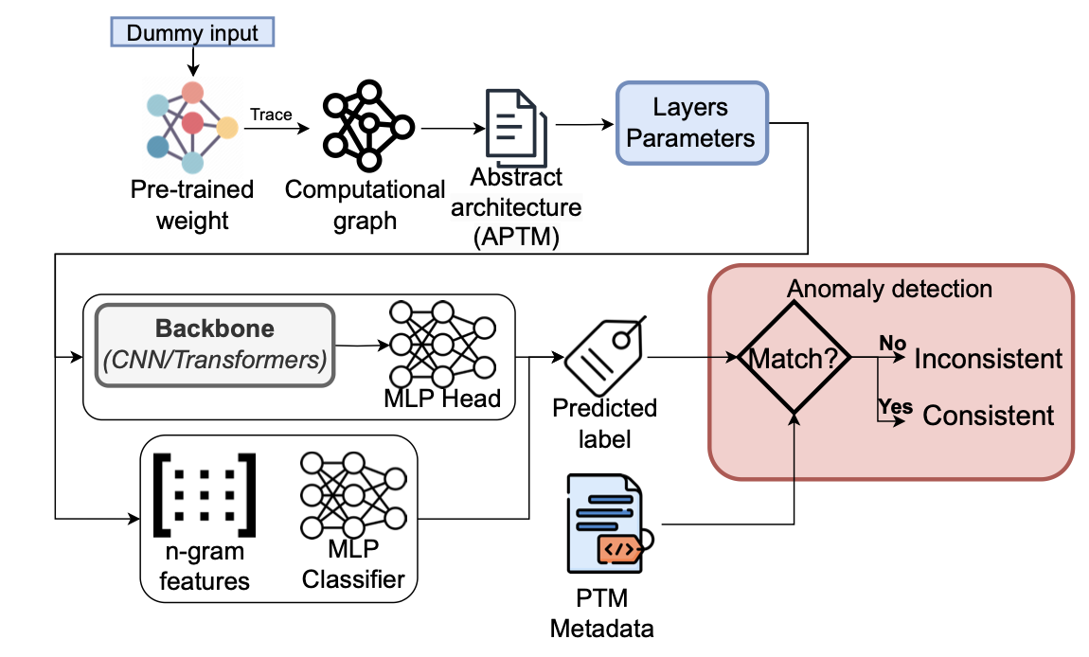
DNN ARchitecture Assessment (DARA) - Overview
Notes:
N-gram + MLP classifier (Multi‑Layer Perceptron)
CNN
Transformers (Vanilla finetuning)
Transformers (Continued Pretraining)
Transformers (Finetuning w/ CL)

Slide 53
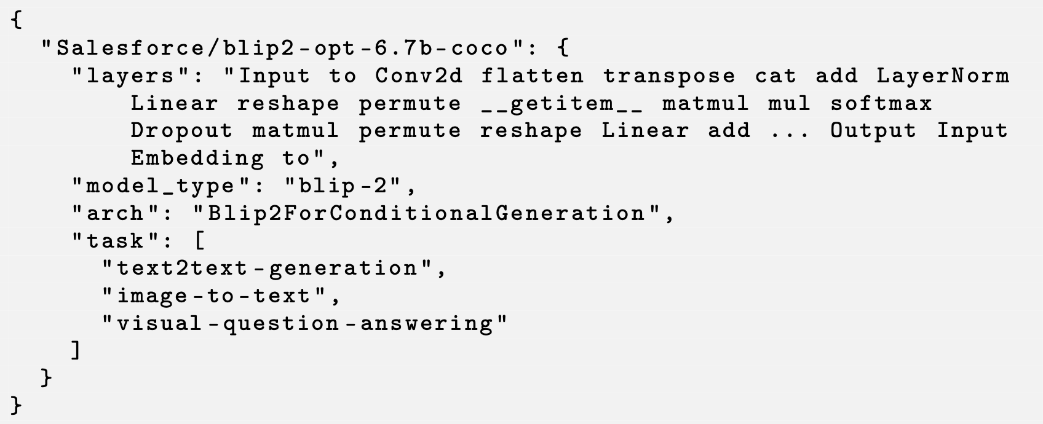
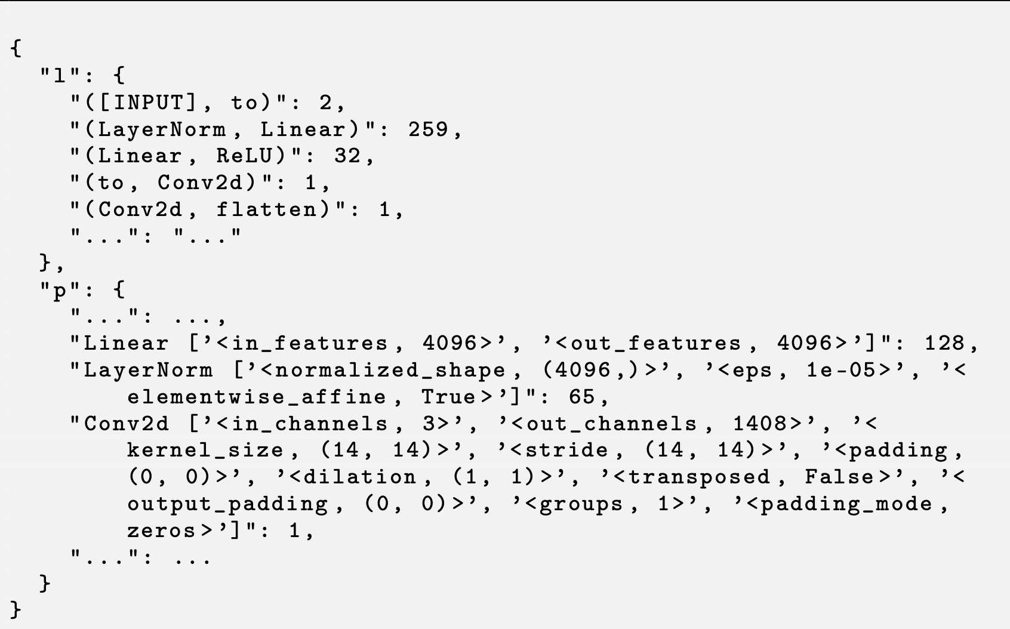
Design of DARA – Feature Extraction
1. N-gram features
2. Advanced sequential feature
Notes:
N-gram + MLP classifier (Multi‑Layer Perceptron)
CNN
Transformers (Vanilla finetuning)
Transformers (Continued Pretraining)
Transformers (Finetuning w/ CL)

Slide 54
Design of DARA – Anomaly Detection
BERT
GPT
Notes:
N-gram + MLP classifier (Multi‑Layer Perceptron)
CNN
Transformers (Vanilla finetuning)
Transformers (Continued Pretraining)
Transformers (Finetuning w/ CL)

Slide 55
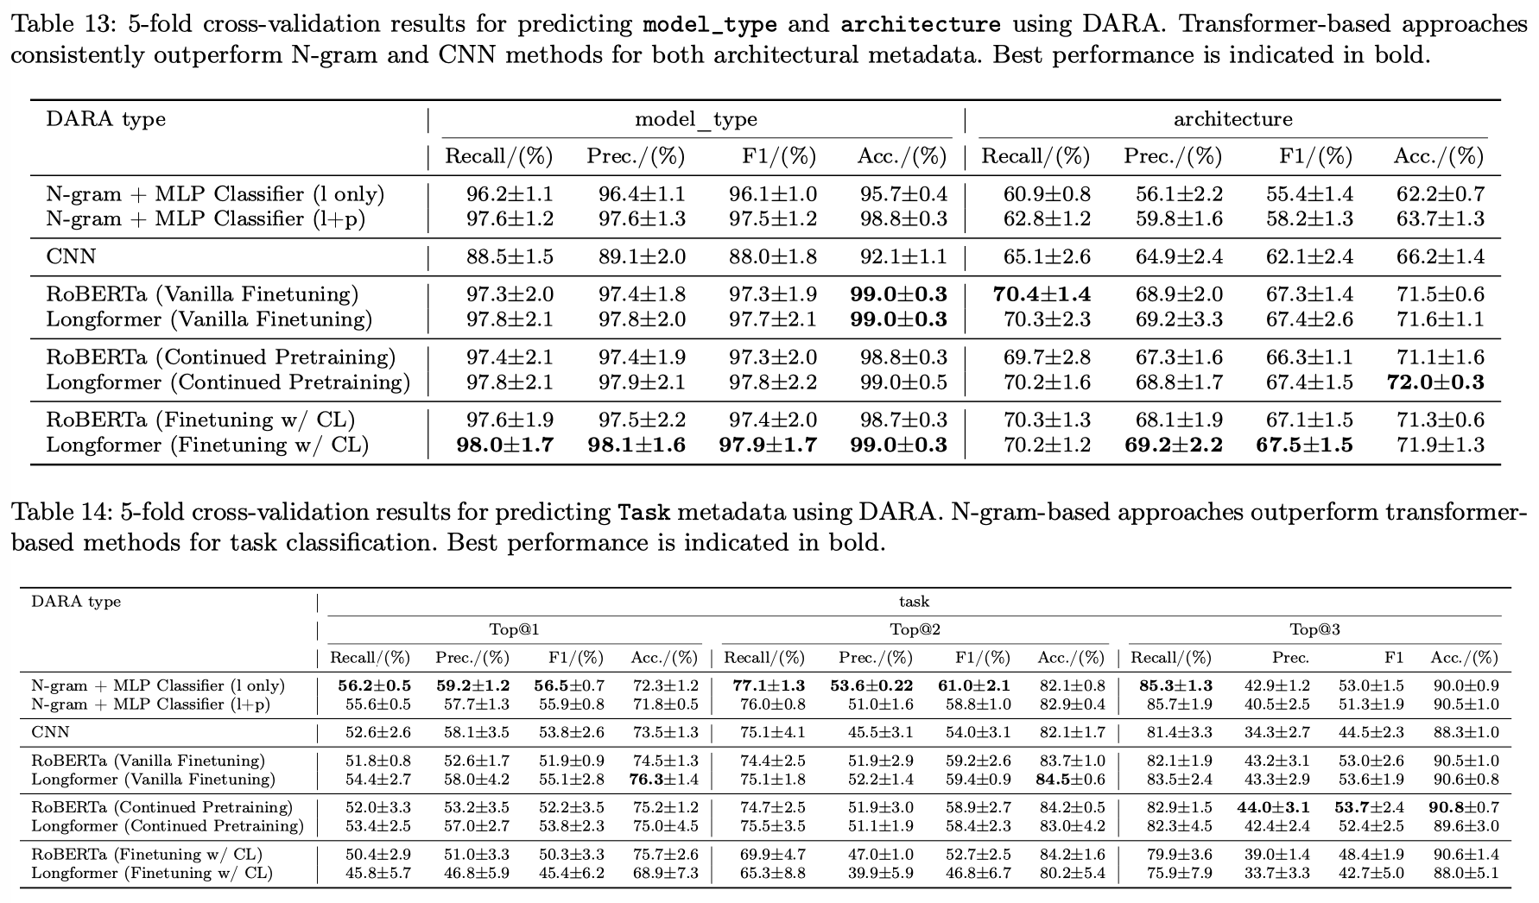
DARA Effectiveness: high accuracy for model_type
Notes:
Evaluation:
Overall, we collected 3443 PTM packages from 172 architectures, 78 model_types, and 27 tasks
High accuracy for model_type
Moderate accuracy for task and architecture

Slide 56
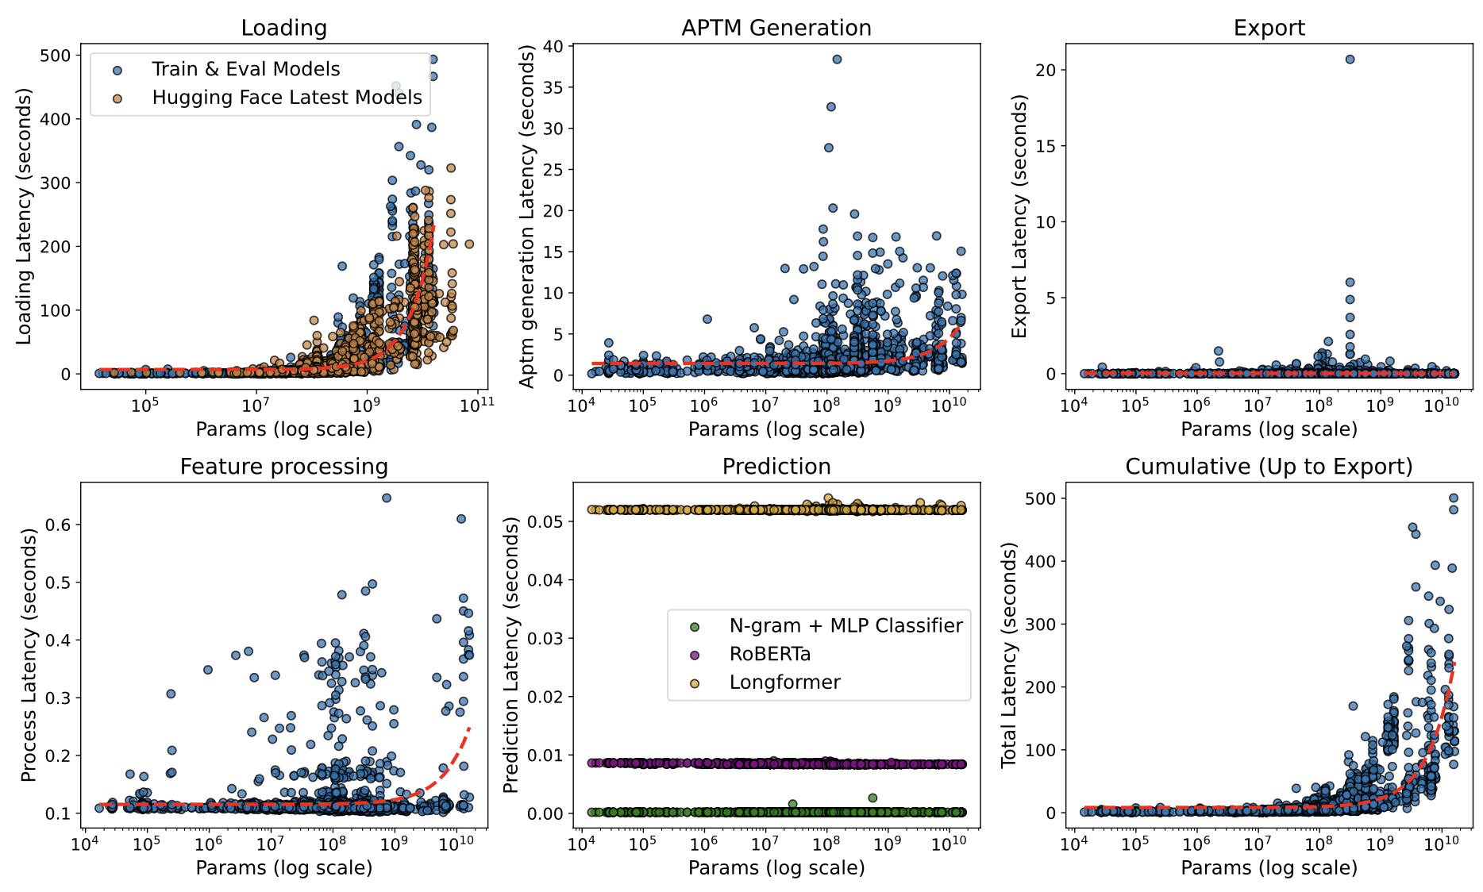
DARA Efficiency: Applicable to Practice
Notes:
Latency measurements for each stage of DARA, including APTM ex-
traction, feature export, feature processing, DARA prediction, model loading, and
total execution time. Red curves show fitted complexity trends based on our algo-
rithmic analysis: quadratic for APTM extraction and feature processing; linear for
feature export and prediction; and exponential for model loading. Orange mark-
ers indicate loading latencies of recent PTM/LLM models. The close alignment of
these points with our fitted distributions demonstrates that our results generalize
to newer models.

Slide 57
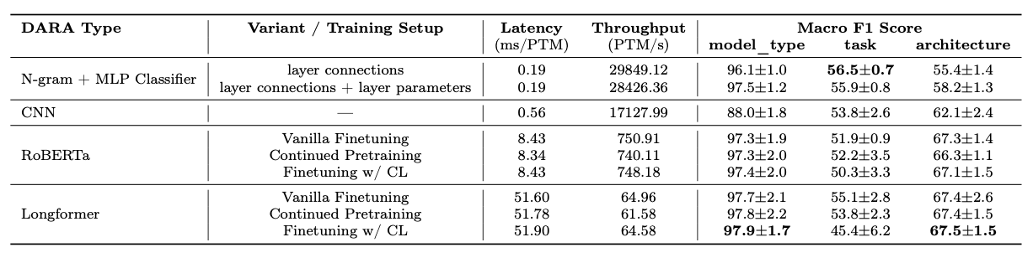
Evaluation of DARA – Comparing DARA Types
N-gram + MLP classifier: Lowest latency
Longformer (Finetuning w/ Contrastive Learning): Highest Accuracy
Notes:
N-gram approaches yield the lowest latency, while
transformer-based methods incur higher latency due to greater model complexity but offer better F1 performance.

Slide 58
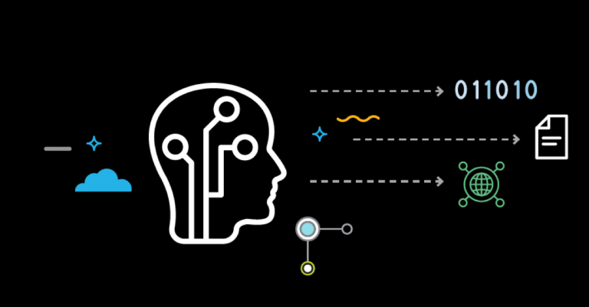


Use Cases of DARA in Practice
Reported anomaly → Inconsistency between the actual architecture and the metadata
If integrated by Hugging Face
Pre-upload verification
Warning system
Post-upload quality flagging
Other use cases
Model Validation
Label Generation and validation
Plagiarism Detection
Notes:
HF:
Pre-upload verification
DARA can analyze the model architecture in the background and suggest appropriate values for model_type, architecture, and task fields, potentially reducing manual errors
Warning system
When inconsistencies are detected, the platform can dis-
play non-blocking warnings to uploaders, allowing them to either confirm their
unusual configuration or correct potential errors before publication.
Post-upload quality flagging
For models already in the repository, identify and flag potential inconsistencies
Other use cases:
Model validation
Validate the architecture for better transparency and trust (avoid backdoors)
Label generation and validation
Better standardization
Plagiarism detection
Unethical behaviour detection

Slide 59
Future Directions
Improving naming standardization through automation
Improving package naming for better model selection and reuse
Securing supply chain by leveraging naming information

Slide 60
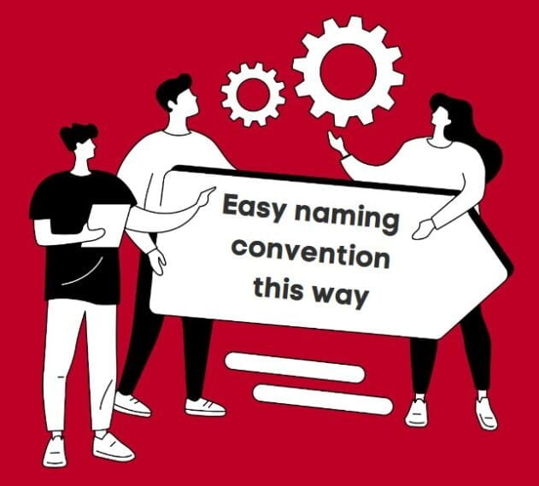
Takeaway Message
Traditional software names prioritize simplicity or branding;
PTM names encode meaningful architectural and functional details
-- more like a hardware spec sheet
Background
Characterization
Enhancement
We developed a DNN ARchitecture Assessment (DARA) System to mitigate naming inconsistencies.
Naming
Inconsistency
Detection
60

Slide 61

Topic 5
Adapting Package Confusion Detection System to AI Model Supply Chain
[Under Review at ICSE’26] Jiang, Çakar, Lysenko, and Davis. Detecting Active and Stealthy Typosquatting Threats in Package Registries. Under Submission at International Conference on Software Engineering (Under Review at ICSE’26), 12 pages.

Slide 62
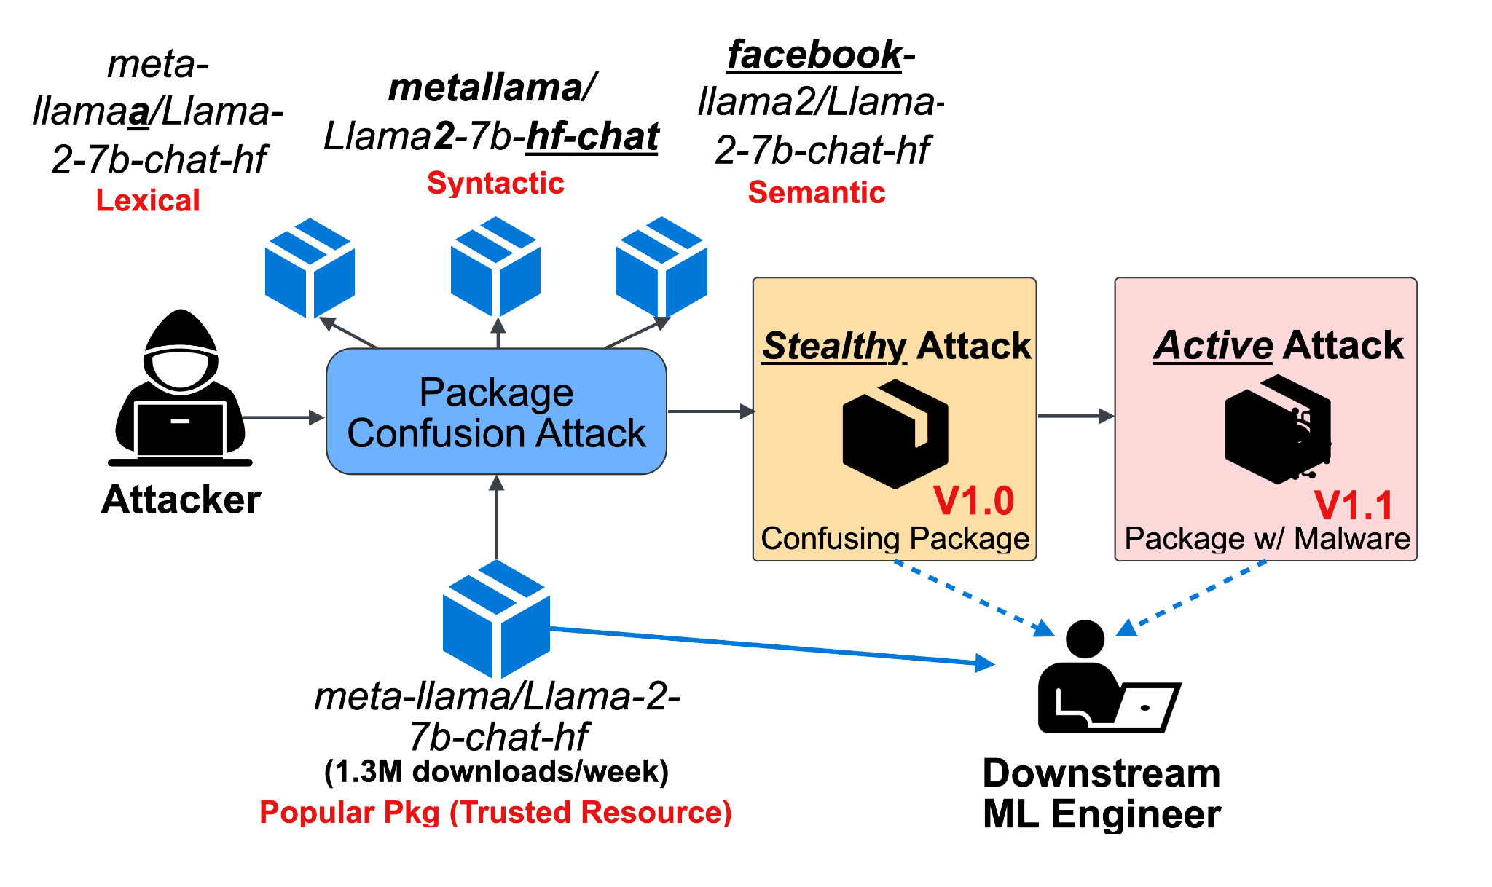
Background: Threat Model of Package Confusion Attack

Slide 63
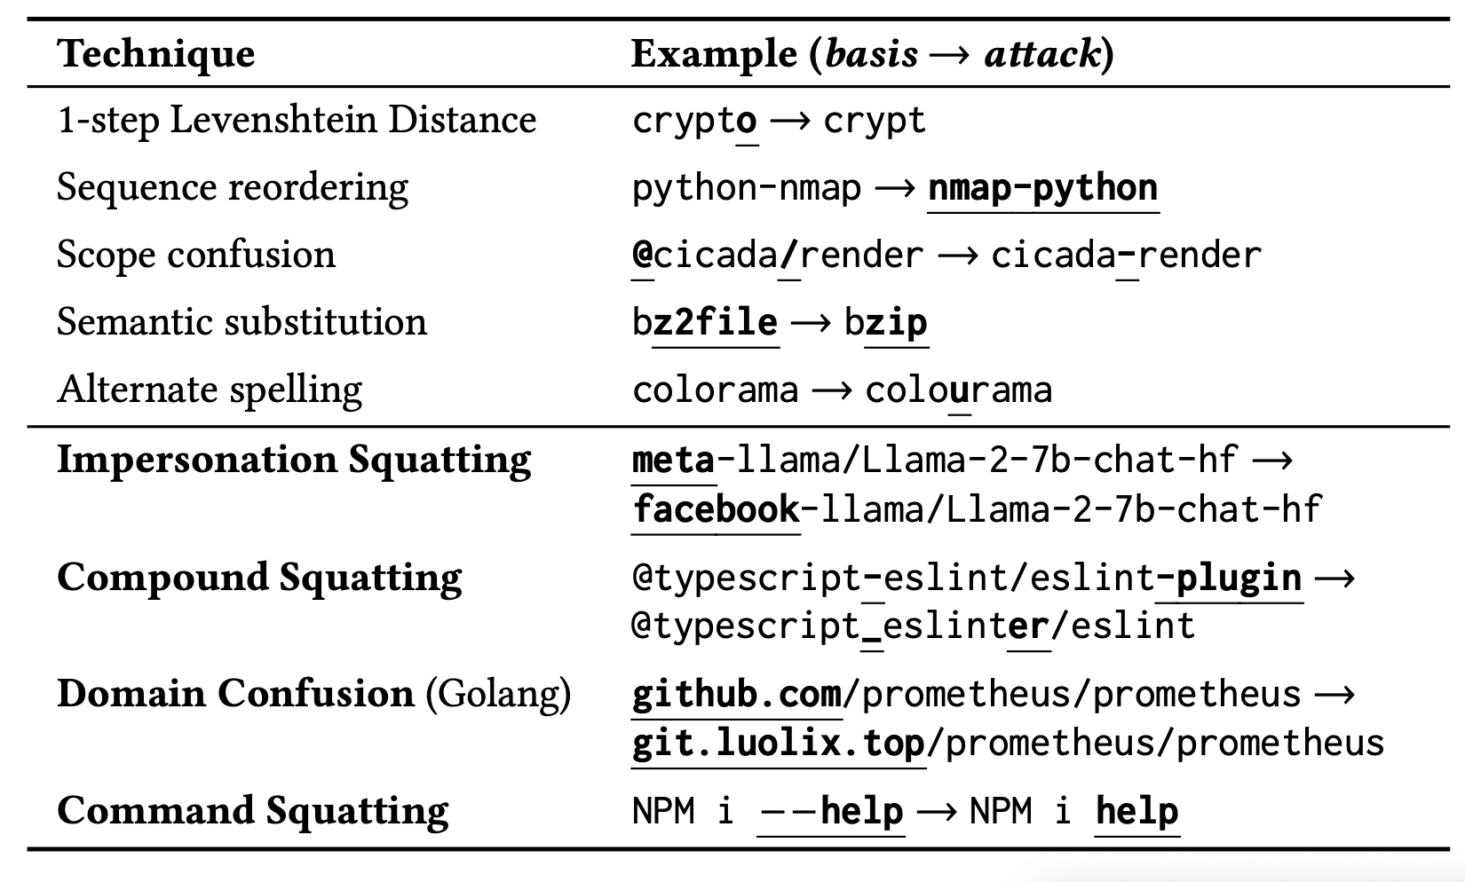
Background: Package Confusion Categories

Slide 64
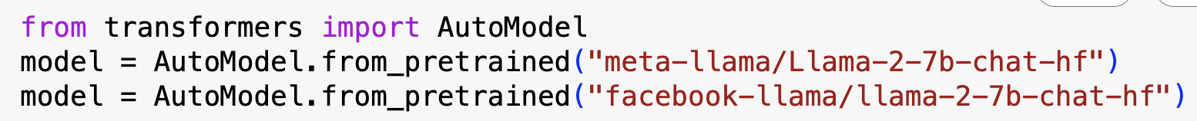

Illustration of Package Confusion Attacks

Slide 65







Organization Confusion
https://huggingface.co/deepseek
https://huggingface.co/deepseek-ai
https://huggingface.co/deepseek-r1
https://huggingface.co/deepseek-v3
✅
https://huggingface.co/meta-llama
https://huggingface.co/facebook-llama
https://huggingface.co/facebook-research
https://huggingface.co/meta-research
✅

Slide 66


Model Confusion Attack is Real

Slide 67


ConfuGuard: Package Confusion Attack Detection
Confuguard is the first system that works for hierarchical naming!
Hierarchical naming ecosystems: Hugging Face (my motivation) and also Maven & Golang

Slide 68








Results – Disclosure of Real Attacks
68

Slide 69
Adapting Confuguard to Hugging Face
Popularity threshold:
#monthly downloads > 1000
Out of ~800K PTMs (Nov, 2024)

Slide 70

Results
Popularity threshold:
#monthly downloads > 1000
Out of ~800K PTMs (Nov, 2024)
70

Slide 71
Takeaway Message
PTM supply chain is also vulnerable for package confusion attacks…
PTM package names have unique properties…which makes it complicated to defend…
More semantic information
More forking activities
Fast emergence of new model names
Background
Characterization
Enhancement
Package Confusion
Detection
Naming
Inconsistency
Detection
71
Notes:
unique properties:
semantic information
The rapid emergence of new models

Slide 72
Recommendations & Future Work
AI Supply Chain Analysis
Model Lineage
AI Bill of Material (AIBOM)
Simplify PTM Reengineering
Further analysis on reuse patterns and practices
Validation tools for better reproducibility and replicability
Enhanced Detection of Model Spoofing
Enhanced name spoofing detection
Architectural backdoor
Recommendation for PTM Selection and Reuse
Hardware-aware model recommendation
AutoML tailored for easier reuse
Background
Characterization
Enhancement
72

Slide 73
Discussion and Conclusion
73

Slide 74
Thesis Summary
Background
Trad. Software
Reuse
Trust
PTMs
Reuse
Characterization
Trust
This Thesis
Enhancement
Characterizing the open problems of trustworthy PTM reuse
Developing tools to improve PTM trustworthiness and reusability
Publishing datasets for the larger research community
74
Notes:
This thesis addresses this gap by understanding and improving the trustworthiness and reusability of open-source Pre-Trained AI Models (PTMs) through:

Slide 75






Acknowledgements
75

Slide 76
THANK YOU!
jiang784@purdue.edu

Slide 77
Bonus Slides
Notes:
Consider the software engineer.
* What tasks do they perform?
- Lots of traditional activities such as computer programming, data management, data transmission, collaborative engineering, and deployment. More recently working with machine learning technologies such as neural networks.
What tools do they use to assist them in these tasks?
*Flip through some tool families
One aspect of software engineering research is to understand the ways that engineers use these tools, in order to
1.Identify problems with the tools
2.Identify ways we can improve these tools
3.Identify opportunities for new tools
When tools are used incorrectly, bad things happen.
The engineering process may be inefficient, or the quality of the engineering product may be affected.
TRANS
Today I’m going to talk about engineering practices and challenges for one of these domains: machine learning, and specifically, deep learning / neural networks.
=====
Editing:
-VSCode
-IntelliJ
-Eclipse
-Emacs
Interacting with data
-MySQL
-MongoDB (noSQL)
-GraphQL
Communication:
-JSON
-Protobuf
Working with other developers:
-Version control
-CI tools like Travis
Virtualization:
- Docker
- Kubernetes
Deployment, e.g. serverless frameworks like
- AWS lambda
- Google cloud functions
-Apache OpenWhisk
-
Neural networks:
- Development frameworks like PyTorch and TensorFlow; model hubs such as HuggingFace; exchange formats such as ONNX

Slide 78
Summary of Contributions
My work addresses this gap by applying software engineering approaches to：
Characterize the open problems of trustworthy PTM reuse
Develop tools to improve PTM trustworthiness and reusability
Publish datasets for the larger research community
Research Methods:
Empirical research
Software repository analysis ("mining software repositories")
Automated tool development
Notes:
The engineering community faces a foundational gap in understanding challenges and best practices for reuse activities in the PTM supply chain.

Slide 79
Bonus Slides - Topic 1

Slide 80


Definition of DL Reengineering (4 kinds)
Reuse: same code + same dataset
Replicate: same algorithm, data, configuration, in distinct implementation
Adapt: different dataset
Enhance: add new feature
27

Slide 81

Why DL Reengineering?
Common practice but challenging!
Under-documented reference models
Changing requirements (SW, HW)
High cost of implementation and testing
Different specializations (e.g., software engineering, data science)
Liu et al. [FSE’20], Pham et al. [ASE’20], Pineau et al. [NeurIPS’21]
https://ai.meta.com/blog/how-the-ai-community-can-get-serious-about-reproducibility/
https://www.amazon.science/publications/on-challenges-in-machine-learning-model-management
81

Slide 82
Research Questions & Methods

Slide 83
Research questions
Theme 1: Quantitative - Understanding defect characteristics
RQ1: Common defect manifestation?
RQ2: Frequent general programming defects?
RQ3: Common symptoms?
RQ4: Common DL-specific defects?
Theme 2: Qualitative - Underlying challenges and practices
RQ5: Practices and challenges?

Slide 84


A Case Study on Computer Vision
Why Computer Vision?
Major application of DL
Techniques are shared between computer vision and other applications of deep learning
The engineering process is consistent across different domains
Generalizable?

Slide 85

Methodology - Overview

Slide 86
Theme 1 - Quantitative
Understanding defect characteristics

Slide 87



Relationship between Reengineering Repositories
Research
prototypes
1.2K forks
Replications
User “forks”
1.6K forks
4.1K forks

Slide 88



Methodology - Quantitative Study (RQ1-RQ4)
Repository Selection
+
19 Solo Repositories 8 Zoo Repositories
Issue Selection
334 issues → 348 defects
Reengineering Issue Examples:
Non-reengineering Issue Examples:
Non-defect Issue Examples:
Issue Analysis

Slide 89

Results – Symptoms: most defects in training didn’t result in crashes

Slide 90

Results – DL-Specific Defects: distinct root causes for the observed symptoms
DL-specific defect types
Symptoms

Slide 91
Theme 2 - Qualitative
Underlying challenges and practices

Slide 92








Method of Theme 2 - Qualitative Study (RQ5)
7 Internal interview subjects — Student Reengineering Team (2-year effort)
✖️
7,643 LOC
$105K total
$15K/model
“An Experience Report on Machine Learning Reproducibility: Guidance for Practitioners and TensorFlow Model Garden Contributors”
“A Partial Replication of MaskFormer in TensorFlow on TPUs for the TensorFlow Model Garden”
7 models

Slide 93




Method of Theme 2 - Qualitative Study (RQ5)
6 External Interview Subjects
2 open-source contributors recruited from theme 1 projects
4 practitioners recruited from social media platforms

Slide 94
Future Directions
Standardized Practices
Support for Reengineering Validation
Beyond manual reengineering
Further empirical work

Slide 95
Bonus Slides - Topic 2

Slide 96
Engineering reuse process
Integrate/Deploy
What is prioritized?​
What is challenging?​
What is prioritized?​
Any risks?
Reengineer candidate(s)​
Evaluate candidates​
What is available?​
Identify candidates​
PTM Supply Chain
Specify requirement

Slide 97
Topic 2
Trustworthy Reuse of PTMs
Selected Results
[SCORED’22, ICSE’23, ESEM’24]
Notes:
Consider the software engineer.
* What tasks do they perform?
- Lots of traditional activities such as computer programming, data management, data transmission, collaborative engineering, and deployment. More recently working with machine learning technologies such as neural networks.
What tools do they use to assist them in these tasks?
*Flip through some tool families
One aspect of software engineering research is to understand the ways that engineers use these tools, in order to
1.Identify problems with the tools
2.Identify ways we can improve these tools
3.Identify opportunities for new tools
When tools are used incorrectly, bad things happen.
The engineering process may be inefficient, or the quality of the engineering product may be affected.
TRANS
Today I’m going to talk about engineering practices and challenges for one of these domains: machine learning, and specifically, deep learning / neural networks.
=====
Editing:
-VSCode
-IntelliJ
-Eclipse
-Emacs
Interacting with data
-MySQL
-MongoDB (noSQL)
-GraphQL
Communication:
-JSON
-Protobuf
Working with other developers:
-Version control
-CI tools like Travis
Virtualization:
- Docker
- Kubernetes
Deployment, e.g. serverless frameworks like
- AWS lambda
- Google cloud functions
-Apache OpenWhisk
-
Neural networks:
- Development frameworks like PyTorch and TensorFlow; model hubs such as HuggingFace; exchange formats such as ONNX

Slide 98
What is available?
Three types of model hubs
[SCORED’22]

Slide 99

Model Hub Identification (as of 2022)
Keywords in major search engine
Selection criteria: definition, website, documentation
Result: 8 model hubs
Open
Anyone
Gated
Approved contributors
Commercial
Internal engineers
Notes:
-Keywords: ML model hub, DL model hub
-Selection criteria:
-Match our definition of model hub (i.e. a collection of models and datasets organized by problem domain)
-Should have a website -> instead of only have github repo
-The documentation should be accessible -> analyze
-Finally, we got 8 model hubs,
- We analyzed the #models, #dataset, and, how the PTMs are contributed and distributed.
-

Slide 100

What is in the hub?
Common property:
A model hub hosts PTMs. It may host other artifacts (e.g. dataset, code).
Model hubs function as a research-to-practice pipeline, more so than in the traditional software supply chain.
Notes:
To understand the typical structure of model hubs, we looked at each of them and collected
- the categories (e.g., computer vision, natural language processing)
- tasks (e.g., image classification, tokenization),
- and statistics of models and datasets
We found that all model hubs had similar categories to offer (e.g., Computer Vision, Natural
Language Processing, etc.), but the model hubs that offered the
greatest flexibility (i.e., Hugging Face) in community contributions
were found to have more tasks and models associated with each
category, a clear advantage of open source model hubs. For example
Hugging Face is an open hub that offers 60,904 models and tasks
while Modelhub is a gated hub that only offers 6 models and tasks.
The distribution of models by category is not uniform. For example, in HuggingFace there are 6 categories but 53% of the models are in one category, nlp category.
Common Property 1: A model hub hosts pre-trained models. It may host other artifacts (e.g., datasets, source code).
Common Property 2: Model hubs function as a research-topractice pipeline, more so than in the traditional software supply chain. Model contributors are either the authors of a model, or are maintaining or fine-tuning an existing model [21]. An author is the researcher(s) who created the original implementation of a model, typically released alongside an academic work [21]. A maintainer is the individual(s) who maintain and expand the properties of an author’s work [89]. This could be done through resolving bugs, improving model performance and accuracy, or providing alternative implementations of the model.

Slide 101


How are Model Hubs Structured for Contributions
Model Hubs
Three types: Open, gated, commercial
Contributing workflow: different Distribution workflow: similar
Model Distribution Workflow

Slide 102
What are the challenges of PTM reuse?
What is prioritized?
How do engineers select PTMs?
What PTM attributes facilitate PTM reuse?
[ICSE’23]
What is challenging?

Slide 103

Methodology - Overview
[ICSE’23]
Notes:
Method, sampling, bias

Slide 104



Methodology - Qualitative Study
[ICSE’23]
Interviews with PTM reusers
Four-step process
(framework analysis method)
•Framework Identification
•Interview Design
Interview protocol
•Recruitment
12 PTM users
•Analysis
Notes:
Method, sampling, bias

Slide 105
What is challenging of PTM Reuse?
Missing attributes 10/12 participants
Discrepancies 9/12 participants
Security concerns 3/12 participants

Slide 106

How do engineers select PTMs?

Slide 107
Methodology - Quantitative Study
[ICSE’23]
Risk Mitigation Measurement
Two-step process (STRIDE)
•Dataflow diagram
• HF’s public documentation
•Trust boundary → STRIDE threats
Notes:
Method, sampling, bias

Slide 108



Risks: low adoption of security features
Dataflow diagram for PTMs on Hugging Face:
Notes:
-
-Remind method: We used STRIDE analysis to measure the risks on HF. The frist step is to depict a dataflow based on HF documentation.
-The diagram include two sides, HF user workflow and HF components.
-Here we will show you an example:
-The users contribute models to HF.
-
-We examine the points where HF is mitigating threats. Let's talk about three of them:
-- TODO: This is to mitigate the ..., then the problem we observed.
-With verified organizations. out of 6K organizations, only 200 were verified. 3%.
-
-ClamAV: Out of all the packages, HF puts a warning label for the pacakges with a virus/malware. However, our measurement shows that none of them were flagged. No packages are actually flagged and we also know that this is only checked by traditional code, not neural network.
-
-Commit signing:
-Number: only 3% of all models adopted this feature.
-The limited usage of GPG commit signing exposes models hosted on Hugging Face to Tampering. These models face the risk of Tampering because attackers could contribute malicious code or edit commit history.
-
-
-
-====================
-
-Org verification -> The low adoption rate raises the risk of Spoofing: malicious users may masquerade as real organizations, similar to typosquatting
-ClamAV -> elevation of previledge
-Commit signing:
-The limited usage of GPG commit signing exposes models hosted on Hugging Face to Tampering. These models face the risk of Tampering because attackers could contribute malicious code or edit commit history.
-
-Title: Six Mitigations...(bold)not adopted
-==
-
-
-Although Hugging Face offers mitigations for many risks, these mitigations are incomplete or not widely adopted (Table IV)
-These risks make the existence of malicious models possible in the model registries.
-User permission model
-One shortcoming of the permission model is that Hugging Face organizations violate the principle of least privilege [81]: an organization member with Write privilege can modify any PTM owned by the organization. Therefore, an attacker could contribute malicious code, thereby raising the risk of Elevation of Privileges.
-Organization verification:
-We counted the number of verified organizations via web scraping. Out of 6,243 organizations, only 199 (3.19%) were verified.
-The low adoption rate raises the risk of Spoofing: malicious users may masquerade as real organizations, similar to typosquatting
-ClamAV
-
-Commit hash checkout:
-It is not easily measured (performed by users on their own machines), we measured the use and scope of the others within the Hugging Face ecosystem
-GPG commit signing
-The limited usage of GPG commit signing exposes models hosted on Hugging Face to Spoofing, Tampering, and Repudiation risks. First, unsigned Hugging Face models are vulnerable to Spoofing since attackers could make commits under the alias of a legitimate maintainer. Second, these models face the risk of Tampering because attackers could contribute malicious code or edit commit history. Finally, unsigned models could also risk repudiation since a lack of verified commit history allows an individual to deny actions within a repository.
-Model cards: I will talk more details in the next two slides.
-Dependencies
-Figure: Number of models trained on a specific dataset (blue) and trained with a specific model architecture (orange).
-**1,207 models were trained on the most popular dataset. 1,673 models depend on the most popular architecture.
-many models depend on the works of others that can be maliciously tampered with. In tampering with these dependencies, BadNets [59] and unethical models [77] can be created, which could affect downstream PTMs.
-PTM Documentation
-Figure: The proportion of models with standardized claims (Hugging Face’s YAML format) for each type of PTM

Slide 109
Bonus Slides - Topic 3

Slide 110


Dataset 1: PTMTorrent
[MSR-Dataset’23]

Slide 111
There are still gaps…
Lack of standardized PTM metadata across multiple hubs.
The downstream applications (GitHub) of PTM supply chain was missing in the existing datasets.

Slide 112


Dataset 2: PeaTMOSS
[MSR’24]
PTM supply chain:
PeaTMOSS:
Pre-Trained Models in Open-Source Software

Slide 113

Dataset 2: PeaTMOSS (Enhancement)

Slide 114

Dataset 2: PeaTMOSS (Enhancement)
Extracted metadata from model cards:

Slide 115

Dataset 2: PeaTMOSS - Example Usage
License Compatibility Measurement:
Notes:
1.Source: Linux Foundation’s OSS license compatibility table
a.Grey: not included in Linux table
b.Blue: compatible
c.Red: incompatible
2.In 25.61% cases, PTM-App licenses are identical
3.In 0.24% cases, the licenses are incompatible, where there is copyleft provisions in the PTM’s license that are not honored by the Application
1.Many downstream GitHub repositories (43.42%) choose not to define a license (“no license” in the figure), instead operating under the default posture of Hugging Face (full reuse [48]) and GitHub (much stricter — copyright reserved to author [40]). In 25.61% of cases, the PTM-Application licenses are identical.
0.24%: this is the result of copyleft provisions in the PTM’s license that are not honored by the Application

Slide 116
Bonus Slides - Topic 4

Slide 117
Bonus Slides - Topic 5

Slide 118

Design of DARA – Computational Graph Conversion
Notes:
Fig. 7: To improve PTM naming accuracies, we propose the DNN ARchitecture
Assessment pipeline (DARA), an anomaly detection algorithm designed to auto-
matically identify discrepancies in PTM names. The approach involves detecting
architectural variations across multiple PTMs, training a classifier, and using it to
spot naming inconsistencies. Metadata inconsistencies are defined as mismatches
between the actual architecture of a PTM and its corresponding metadata. In the
DARA pipeline, these inconsistencies manifest as differences between the classi-
fier’s prediction and the labels provided by the PTM creator. We evaluate DARA
using three key labels: model_type, task, and architecture (Figure 2).

Slide 119
Design of DARA – Feature Extraction
Notes:
Fig. 7: To improve PTM naming accuracies, we propose the DNN ARchitecture
Assessment pipeline (DARA), an anomaly detection algorithm designed to auto-
matically identify discrepancies in PTM names. The approach involves detecting
architectural variations across multiple PTMs, training a classifier, and using it to
spot naming inconsistencies. Metadata inconsistencies are defined as mismatches
between the actual architecture of a PTM and its corresponding metadata. In the
DARA pipeline, these inconsistencies manifest as differences between the classi-
fier’s prediction and the labels provided by the PTM creator. We evaluate DARA
using three key labels: model_type, task, and architecture (Figure 2).

Slide 120

Design of DARA – Anomaly Detection
Notes:
Fig. 7: To improve PTM naming accuracies, we propose the DNN ARchitecture
Assessment pipeline (DARA), an anomaly detection algorithm designed to auto-
matically identify discrepancies in PTM names. The approach involves detecting
architectural variations across multiple PTMs, training a classifier, and using it to
spot naming inconsistencies. Metadata inconsistencies are defined as mismatches
between the actual architecture of a PTM and its corresponding metadata. In the
DARA pipeline, these inconsistencies manifest as differences between the classi-
fier’s prediction and the labels provided by the PTM creator. We evaluate DARA
using three key labels: model_type, task, and architecture (Figure 2).

Slide 121



Evaluation of DARA – Confusion Matrix of Prediction
Notes:
Evaluation:
Overall, we collected 3443 PTM packages from 172 architectures, 78 model_types, and 27 tasks

